Slide 1
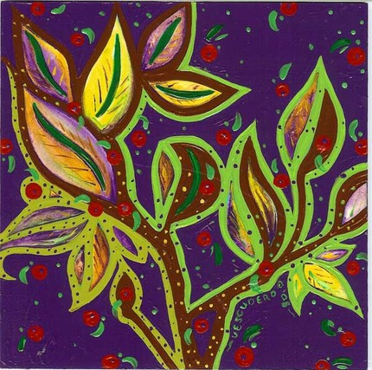
Abstract Expressionism
Abstract Expressionism is a type of art in which the artist expresses himself purely through the use of form and color.

Slide 2
Abstract Expressionism is the first major American avant-garde movement.
Abstract Art is non-representational, or non-objective, art, which means that there are no actual objects represented.
Started in early 1940’s, right after World War II
Abstract Art first emerged from a small group of painters from New York city.
Mainly influenced by the previous Surrealism Art Movement, but with more spontaneous creations.

Slide 3
This movement was influenced by Russian artist, Kandinsky.
Abstract Art is all about what the artist feels and what mood they want to portray. It expresses the artists state of mind.
Abstract Art is all shapes, no real-life images, scenery, or objects, showing refreshing energy like that of the Surrealist artists.
Abstract expressionists value expression over perfection, the unknown over the known, the individual over society, and the inner over the outer.

Slide 4
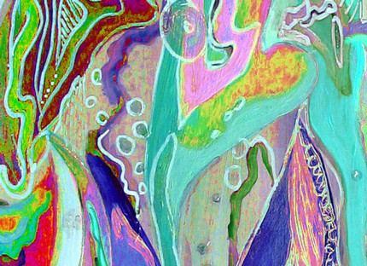
Action Painting
Now considered to be the first American artistic movement of international importance, the term was originally used to describe the work of Willem de Kooning, and Jackson Pollack.
They stressed the physical action involved in painting.
Large canvases that were covered with gestural strokes of fleshy color.

Slide 5
William de Kooning
Canvas = an arena in which to act
Painting has become a record of an event
He painted the subject of the woman for over twenty years.
Early in his career, he was said to be a technical expert with his paint
He was recognized as the leader to the group.

Slide 6
William de Kooning

Slide 7
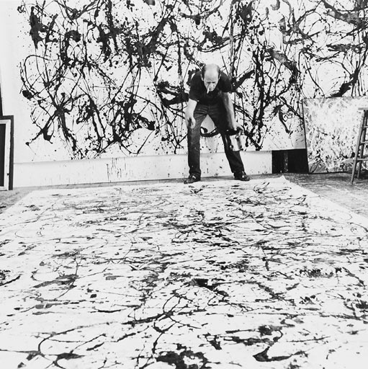
Jackson Pollock
Jackson Pollock started the “drip” technique.
He sold the most expensive painting in the world in 2006. It was called “No. 5” and it sold for $140 million.
His paintings were meant to show the violence we tolerate in America.
His nickname was “Jack the Dripper”.

Slide 8
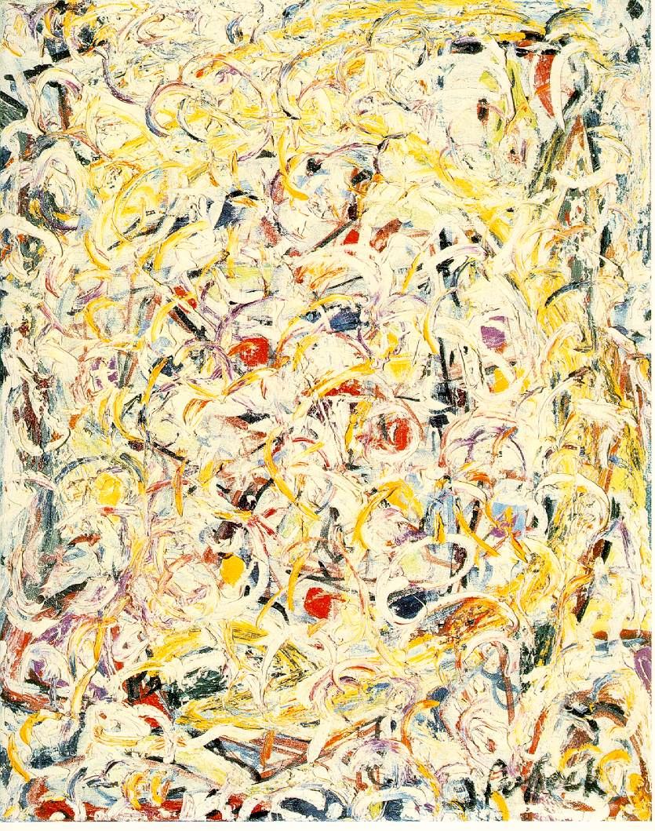
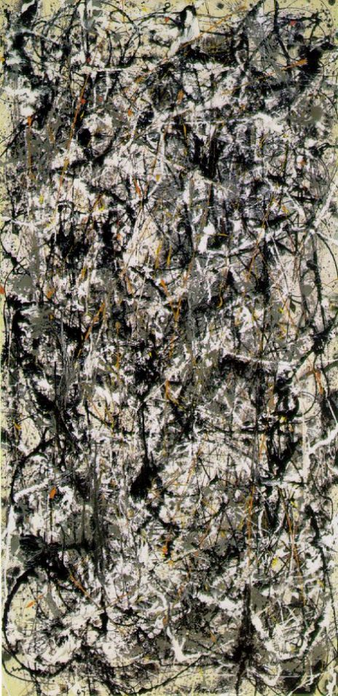
Jackson Pollock

Slide 9
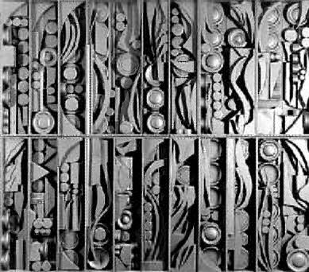
Louise Nevelson
Rough Geometric Shapes
Assemblages
Usually only used found wooden objects

Slide 10
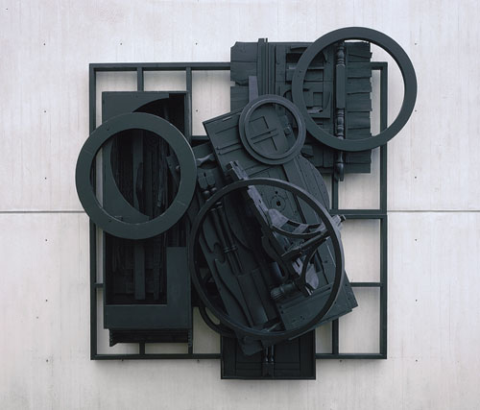
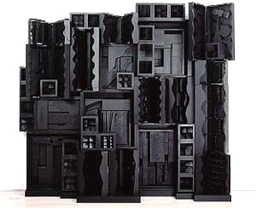
Louise Nevelson

Slide 11
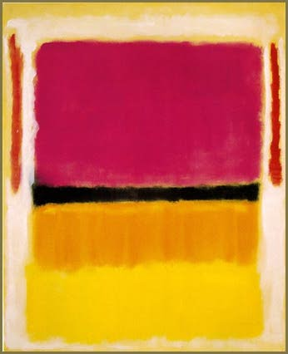
Mark Rothko
Known for Color Field Painting
Mark relies on color and shape to create emotion in the viewer.
Most of his work focuses on exploring the effects of pure color on a canvas.

Slide 12
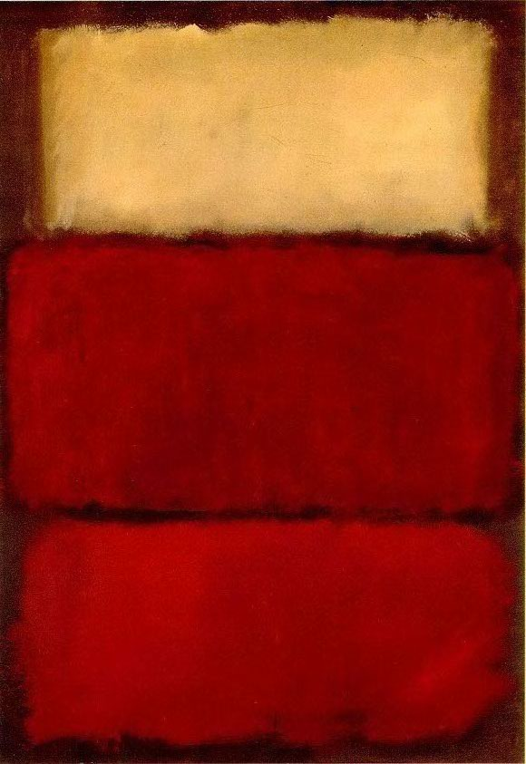
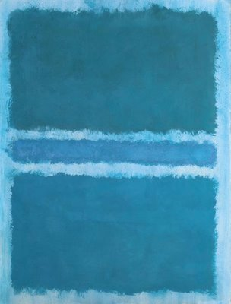
Mark Rothko

Slide 13
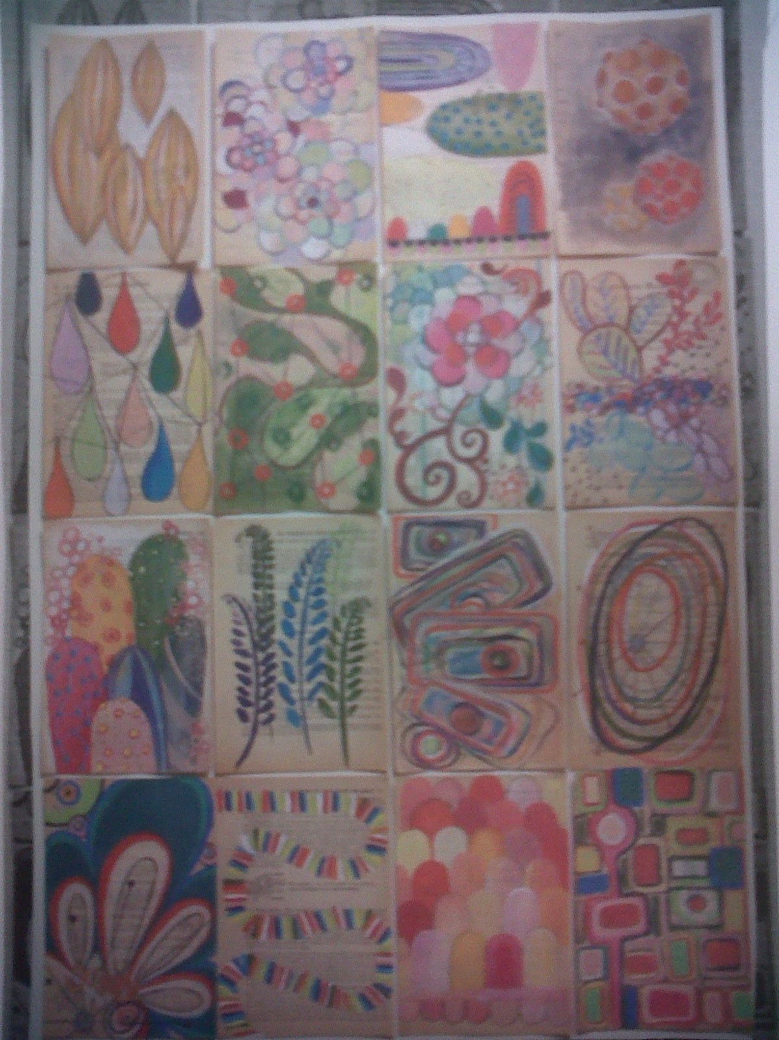
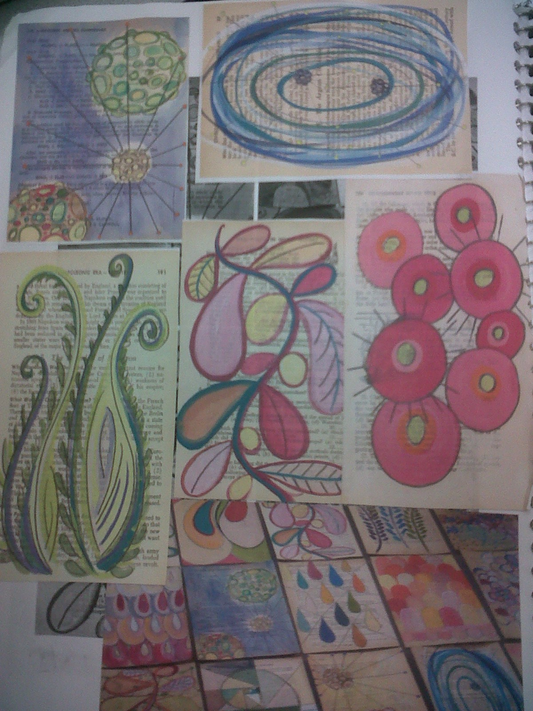

Slide 14
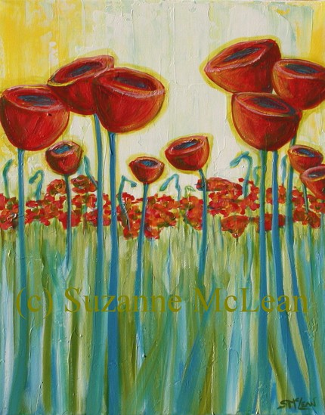
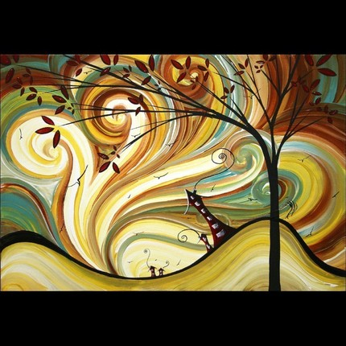

Slide 15
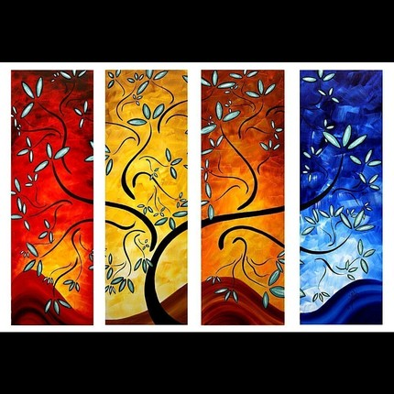
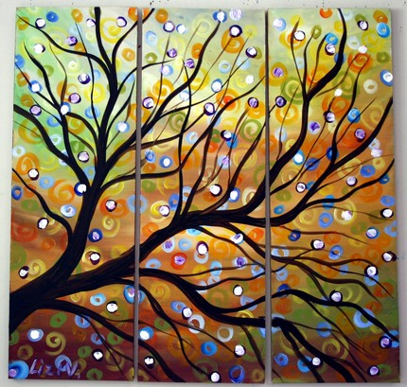

Slide 16
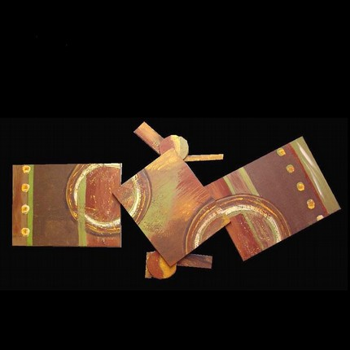
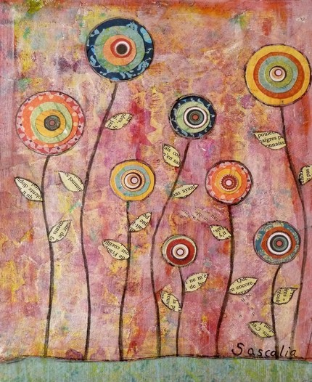

Slide 17
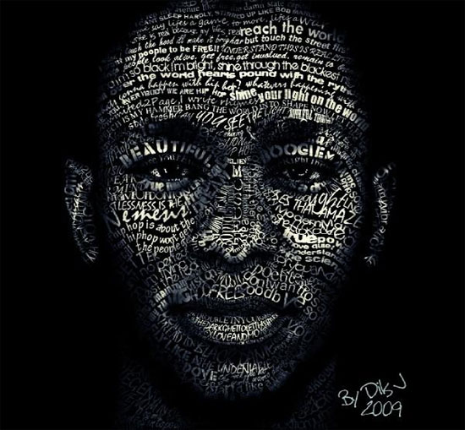
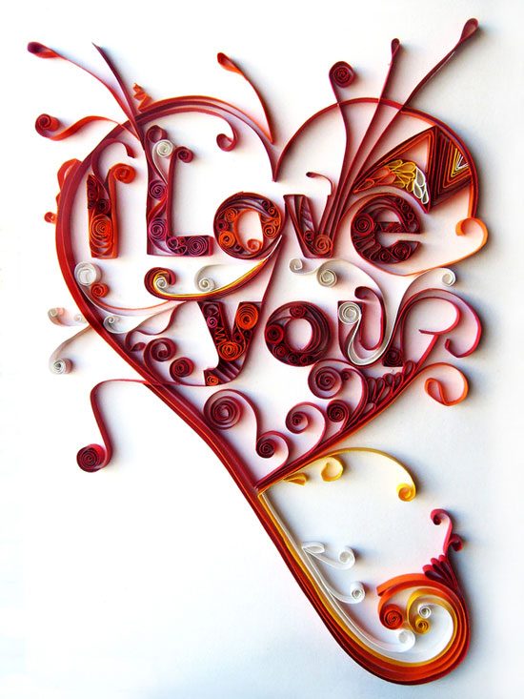
Examples of TYPOGRAPHY

Slide 18
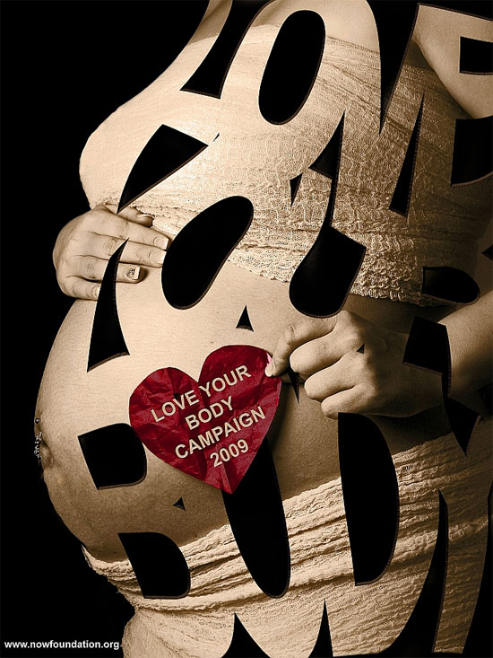
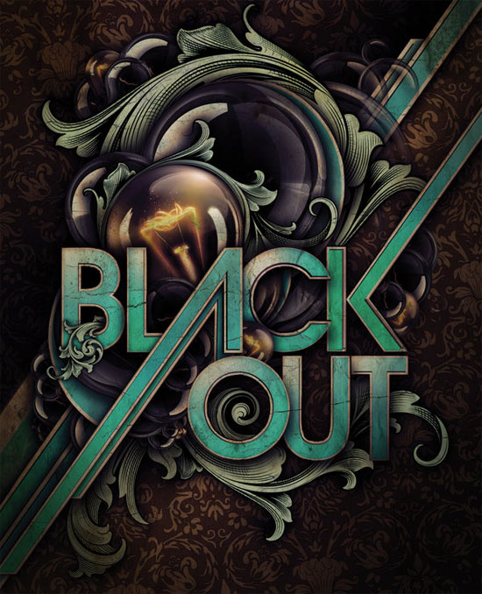

Slide 19
