Slide 1
The Elements of Design

Slide 2
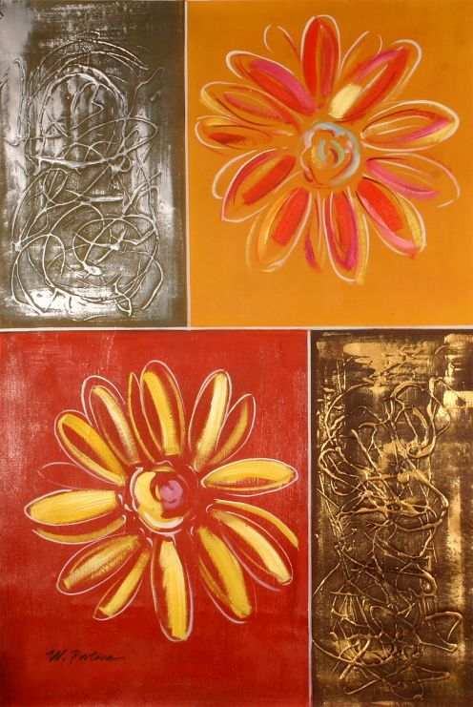
What makes a good piece of artwork?
The composition of a piece of artwork is made up of the arrangement of the elements. These are known as the elements of design.
Every artwork ever made can be described by reference to these elements.

Slide 3
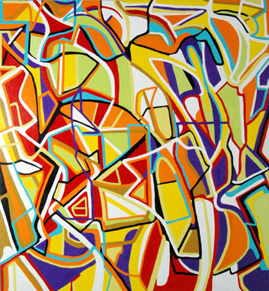
Elements of Design
Line
Shape
Color
Space
Value
Texture
Form

Slide 4
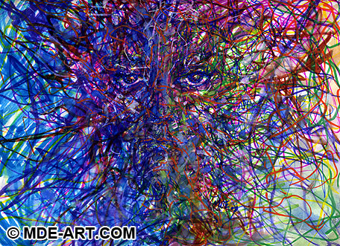
Line
A path of a moving point through space.
A line can differ in:
Length
Width
Texture
Direction
Curve
Lines imply direction and movement
Divide and connect
Imply perspective
Type of Lines:
Implied lines
Gestures
Movement
Contour lines

Slide 5
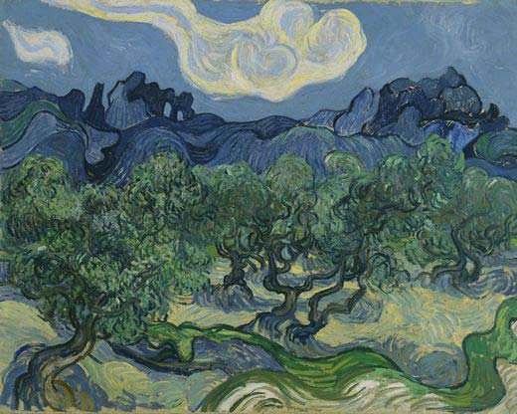
Shape
Shape is a two dimensional area that is defined in some way by a line, an edge, a color, or a texture.
Square
Circle
Rectangle
Triangle
Shapes can be geometric or organic.

Slide 6
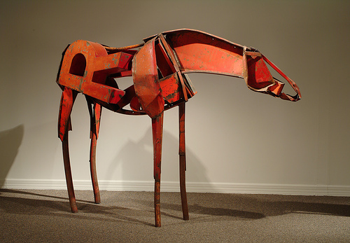
Form
A three-dimensional object
A form has:
Height
Width
Depth

Slide 7
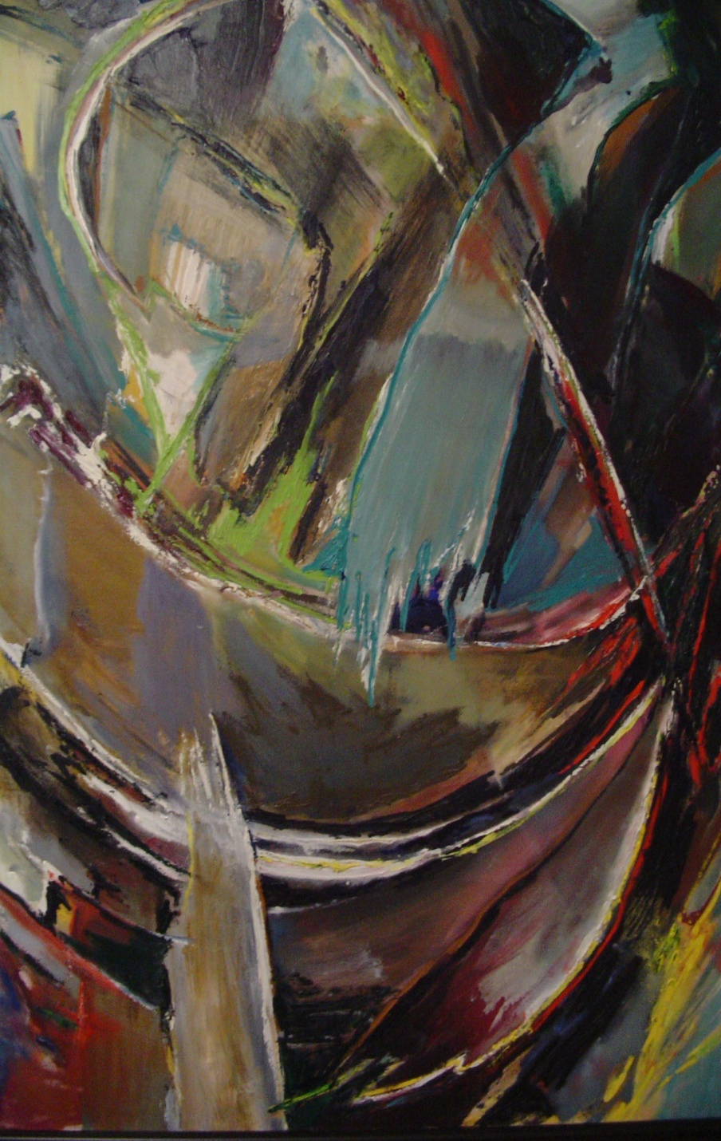
Space
Refers to the emptiness or area between, around, above, below, or within objects.
Two dimensional
Three dimensional
Positive/Negative Space
The shape formed by the figure or subject is the positive space.
The shape of the background is the negative space.
Space can give the illusion of layers, and create a kind of perspective.

Slide 8
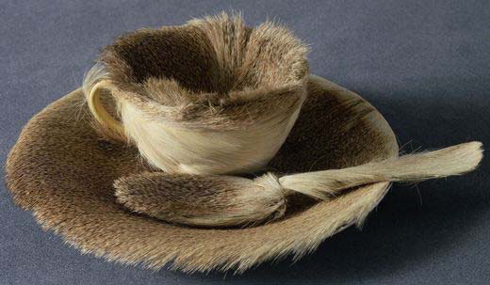
Texture
Gives the viewer a tactile experience
Rough, Smooth, Furry, Shiny, Prickly

Slide 9
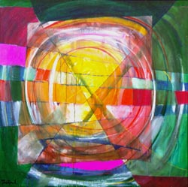
Color
An element of art that is derived from reflected light.
Color is very expressive and can be symbolic or realistic
It appeals strongly to the senses and emotions.

Slide 10
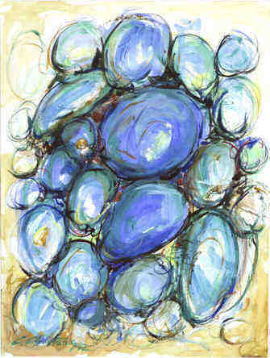
Value
Describes the darkness or lightness of an object
In an image, our eye is usually drawn to the area with highest contrast
Light & darks can be used to model, giving the effect of volume in a two dimensional image
Contrast can be created with opposing color, differences in size, or texture

