Slide 1
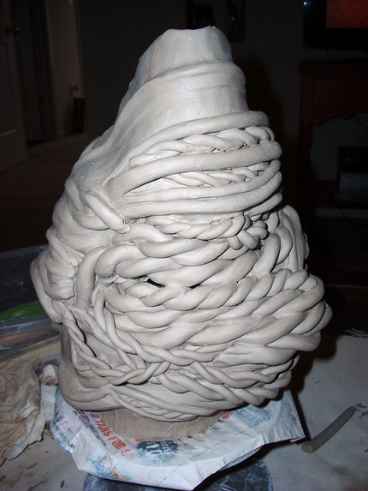
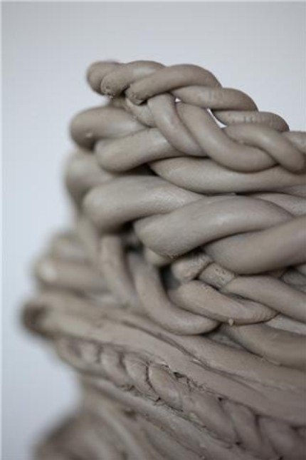
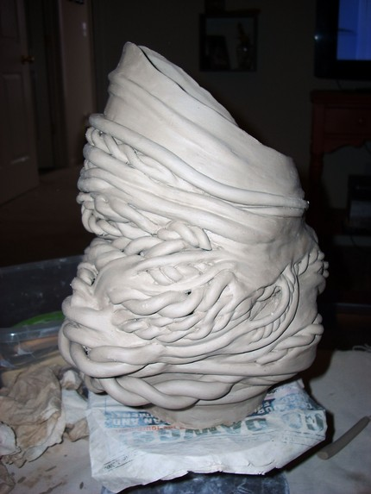
Clay
Clay is a natural substance found all over the world. Clay consists mostly of decomposed rock.
POTTERY- Is a technique using clay to create symmetrical forms on a spinning wheel.

Slide 2
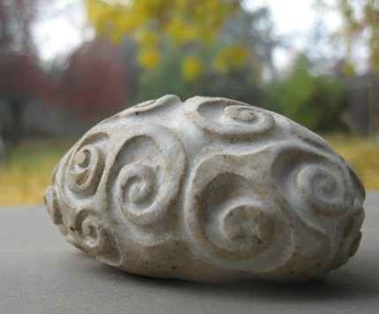
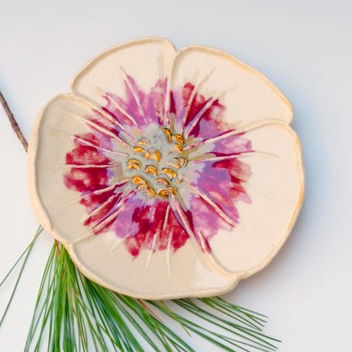
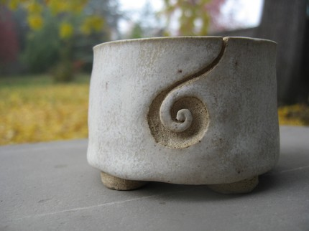
Clay is Soft and Flexible when Wet, Hard when Dry, and Permanent when Fired.
Ceramics- is the Art of making something out of clay.
Ceramic Sculpture- 3-Dimensional Object that has Volume and Mass. A Free-Standing Form that can be seen from the top, bottom, front, back, and both sides and can support itself.

Slide 3
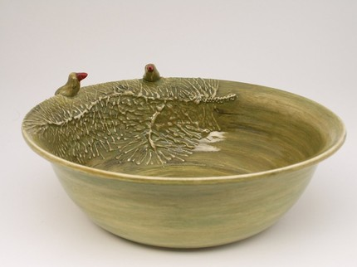
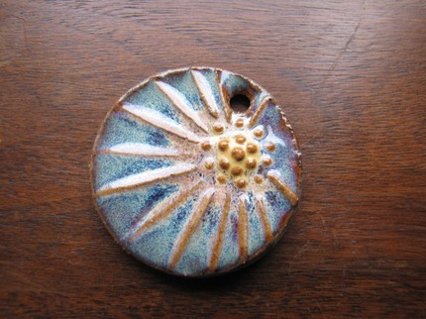
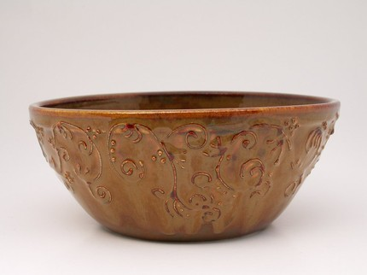
Clay Origins- Since Prehistoric Times, Clay has encouraged a sense of creativity in man. Man has made clay artifacts since the beginning of time.
Functional Artifacts- Bowls, Tools, Weapons, Shelter, Jewelry, etc
Aesthetic Artifacts- Religious Objects or Decorative Items.
High fired ceramics were first produced by the Chinese
Clay is not hard to find, we still have an abundance.
The pottery wheel was first invented by Egyptians.

Slide 4
Stages of drying clay
Green: Clay which is moist and new. Green clay is characterized by its ability to be easily shaped, formed, and added too (embossing).
Leather Hard: Clay which is partially dry. Leather hard clay is characterized by its ability to receive detail (incising). Although leather hard clay will smooth and clean up well, it is also more fragile. Leather hard clay is to dry for embossing.
Bone: Clay which is completely air dried. Bone dry clay is very fragile and no attempts should be made to either emboss or incise. Sweeping with a dry brush is the only acceptable finishing technique. Although fragile, it is necessary for clay to be dried to this state before bisque firing.
Clay in any of the above stages may be placed in water and recycled.

Slide 5
Clay Tools
Your fingers: The finest tool you have. You may shape, smooth and clean better with your hands than almost any other tool.
Pencil: Used for drawing (incising) into the clay. Also great for stamping.
Wire Loop Tools: Used primarily to remove (incise) clay. Wooden Tools: Used primarily to scrape and smooth clay.
Slip: A wet solution made from clay, water, and vinegar. Slip is used as a glue during the embossing process.

Slide 6
Clay Techniques
Embossing: Adding or joining two pieces of clay together. Embossing may only be done during the green drying stage. When embossing you must complete the following steps.
1. Score both pieces to be joined
2. Add slip to both pieces
3. Join the two pieces
Incising: Subtracting clay from the surface of the piece. Carving into, stamping into, drawing into the clay surface are all examples of incising techniques.

Slide 7
Firing Ceramics
Kiln: A furnace is which ceramics are fired, not baked.
Bisque Firing: A slow first firing which takes about 24 hours to complete. The kiln will reach a firing temperature of between 1500-2000 degrees. The ceramics may shrink between 3-7% from their bone dry state. Any cracking will happen during this firing.
Bisque Ware: A piece of ceramic which has been fired once. Bisque ware is now resistant to water.
Glaze Firing: Normally a quicker firing which takes less than 24 hours to complete. The kiln will reach a firing temperature of between 2000-2500 degrees. The exact temperature will depend on the specific glazes which were applied. All work must be raised on stilts or wiped clean where touching kiln shelves.
Glaze Ware: A piece of ceramic which has been fired after glaze was applied (usually 2nd firing). Glazes are solutions of pigment (color), silica (glass), and flux (chemical) which melt at specific temperatures, and when cooled, reveal a layer of smooth, hard glass.

Slide 8
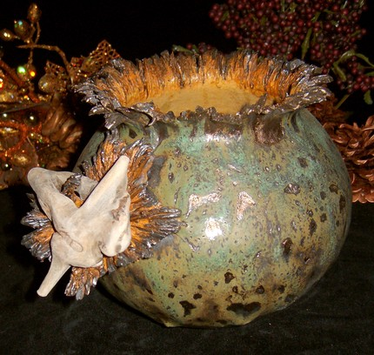
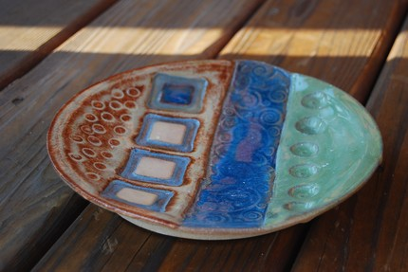
Additive Building- Adding pieces together to create the Object.
Subtractive Building- Carving Clay Away to create the form.
Most glazes today to NOT contain lead in them.

Slide 9
CLAY METHODS
To make a PINCH POT, make a small ball of clay the size of a tennis ball or less, and stick your thumb in the center, making a hole. Then apply pressure with your fingers on the outside and thumb on the inside, creating a rounded bowl shape.
Creating a COIL POT OR COIL STRUCTURE is repetitious, slow and tedious, but the results can be extremely pleasing and original. To make one, create a coil by carefully rolling a lump of clay with all 8 fingers so that it is a nice and even thickness. Coil it upon itself to build the structure up.
The SLAB METHOD allows for the most variation of creations. One can make just about anything out of a slab. A slab is made by rolling the clay with a rolling pin to an even thickness. Once the main body of the slab structure is assembled, it can be paddled, shaped, cut into, twisted, or otherwise formed into the final concept.

Slide 10
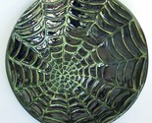
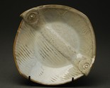
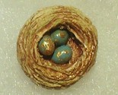
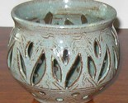
Clay Vocabulary
Wedging- Kneading Clay to remove cracks and bubbles.
Slicing Clay- Cutting Clay to check for cracks and bubbles.
Texturing- Changing the Clay Surface by carving, drawing or stamping into the clay.
Hollowing- Clay cannot be more than 1” Thick- Thicker Clay must be carved out.

Slide 11
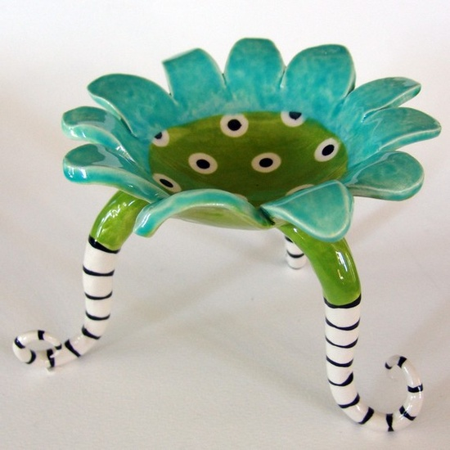
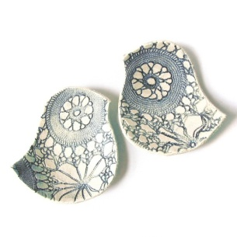
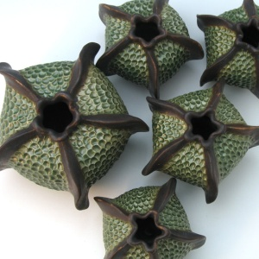
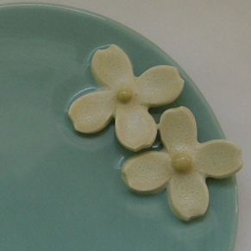
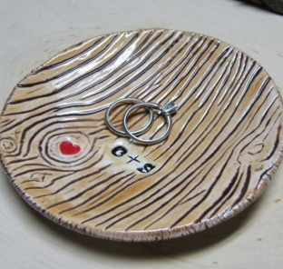
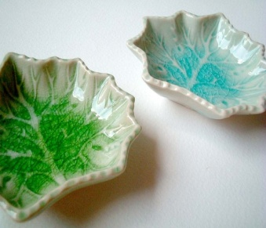
Project 1& 2: Using the pinch pot technique, create a set of Nature vessel or dishes. Create a minimum of 2. There is a wide range of Nature inspired ideas, such as: Flowers, Trees, and Animals etc.

Slide 12
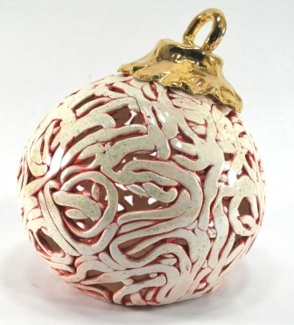
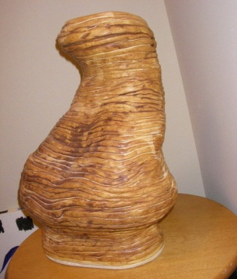
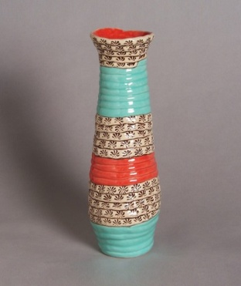
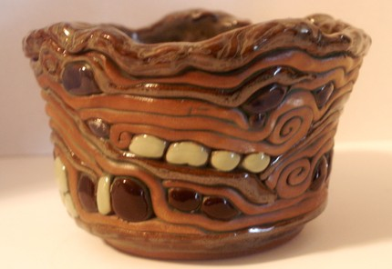
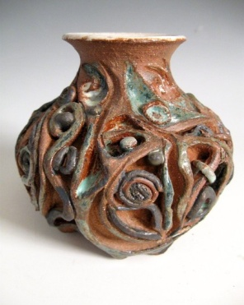
Project 3: Using coiling techniques create a Braided/Coiled Vessel. I encourage creativity with your coils, they do NOT need to look the same, add some of your own personality in the vessel.

Slide 13
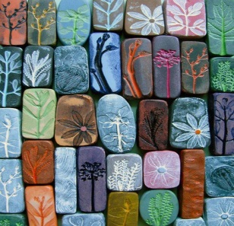
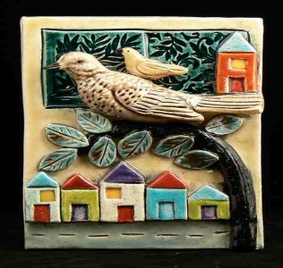
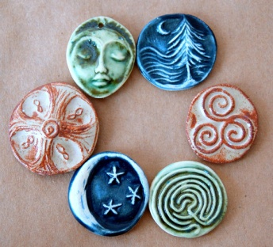
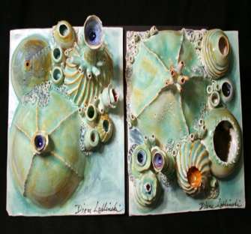
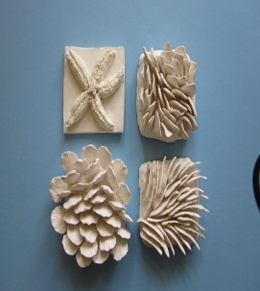
Project 4: Soft Slab/Hard Slab- Using slabs create individual tiles with a unity theme. Use texture and carving to tell the viewer what they are with pictures, words, textures, etc... Put emotion into it.

Slide 14
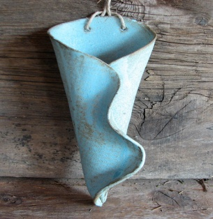
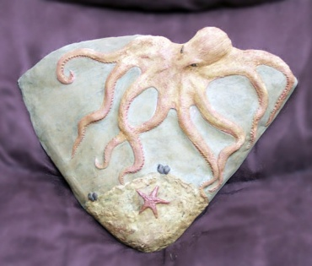
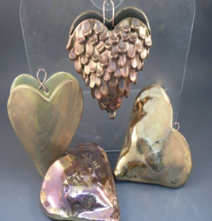
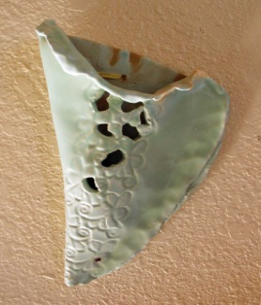
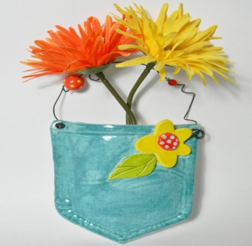
Project 5: Slab Pockets- Using two slabs to create a pocket, joining together, and adding some form of embellishment. You may either incise or emboss on the front pocket.

Slide 15
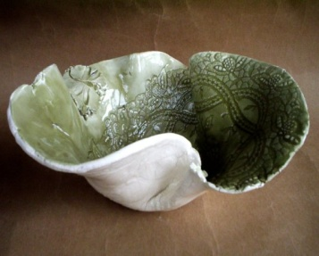
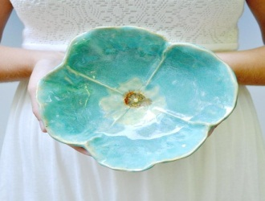
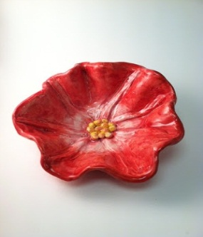
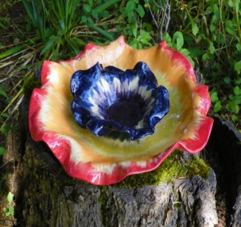
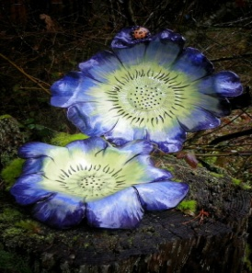
Project 6: Free Form Bowl- Rolling out slabs of clay, cutting in the shape of a circle, and allowing the bowl to shape itself after resting inside another bigger bowl.

Slide 16
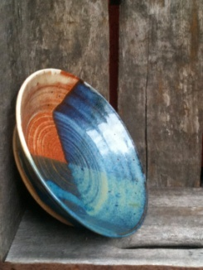
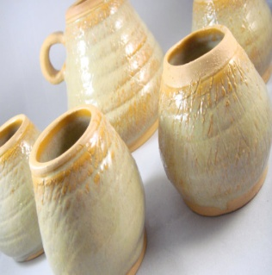
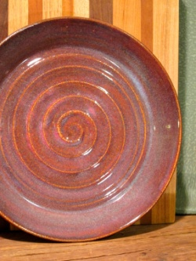
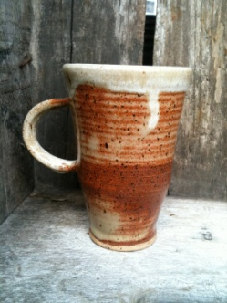
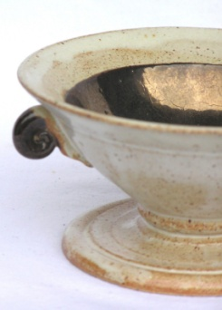
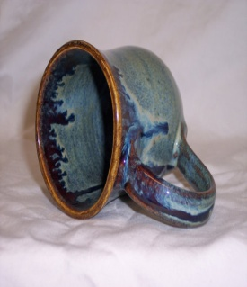
Project 7: Wheel Throwing- Using the basics of wheel throwing create 2 bowls or vessels, using basic centering, pulling, and foot carving.

Slide 17
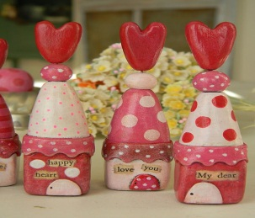
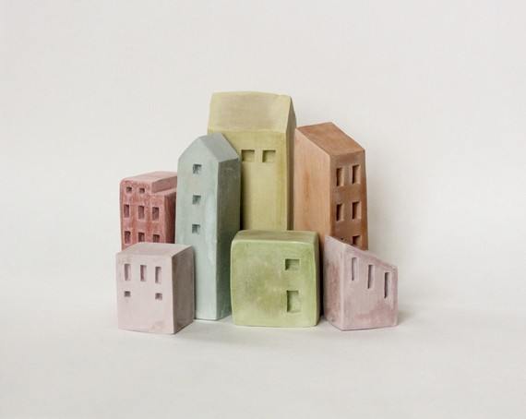
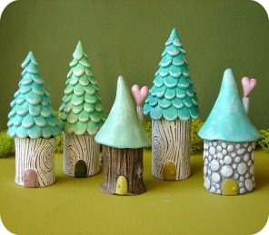
Project 8: MINITATURE Village or city- Design a village, town, or city. You must have at least 10 buildings or houses. The more details you add to your buildings, the better your village will look.

Slide 18
Project 9: REPRESENTATION OF FOOD- Create at least 3 pieces of your favorite foods. Each piece should not exceed over 3 inches, and they should all look as realistic as possible.

Slide 19
Project 10: PROJECT OF YOUR CHOICE. Explore a creative idea/project that you are interested in, there are endless possibilities. For this project you must have multiple pieces, and get it approved by Ms. Powers

