Slide 1
COLOR
In order to see color you must see light. How an object reflects or absorbs light determines what color we perceive that object to be.

Slide 2
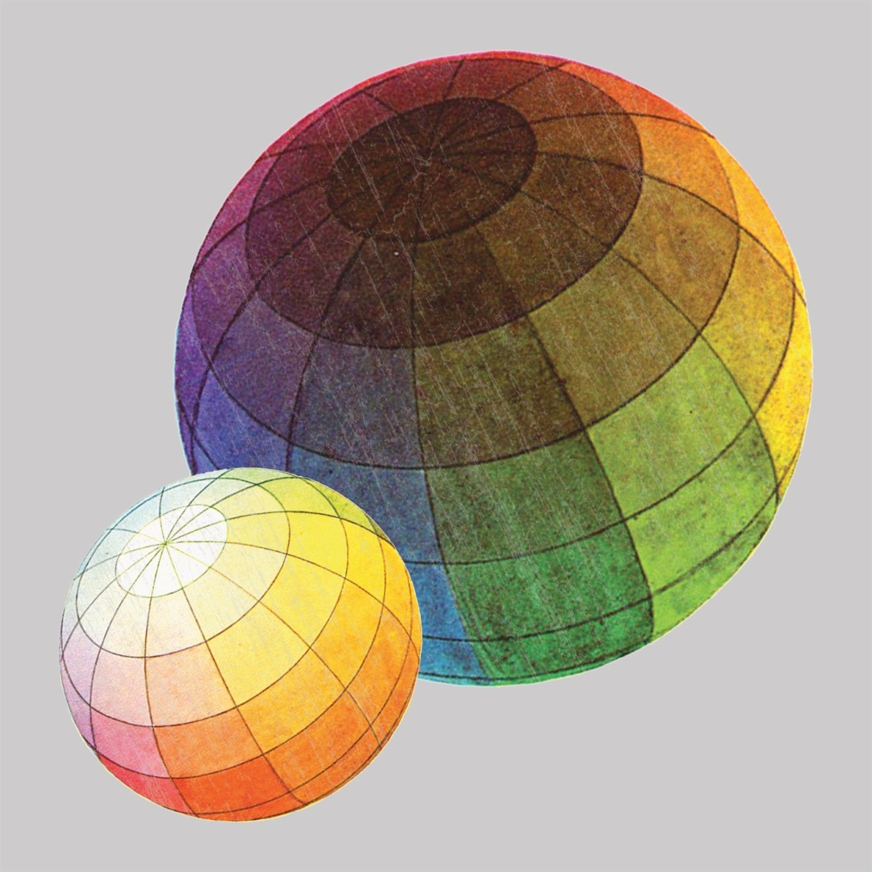
Color Theory
Color is one of the many ways an artist creates visual impact.
Isaac Newton is credited for developing Color Theory.
Colors always follow the order of the Color Wheel.

Slide 3
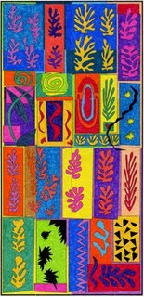
Primary Colors
Red
Yellow
Blue
All three of these are primary colors.
Primary colors can be mixed together to form any other color.
If primary color is missing, you cannot mix any other color to form that missing primary.

Slide 4
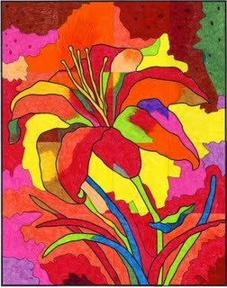
Secondary Colors
Red + Yellow = Orange
Yellow + Blue = Green
Red + Blue = Violet/Purple
All three of these colors are secondary colors.
Secondary colors are formed by mixing two primary colors together.
When arranging a Color Wheel, make sure that the secondary color is placed between the two primary colors that were mixed to form it.

Slide 5
Tertiary/ Intermediate Colors
Red/Orange Yellow/Orange
Yellow/Green Blue/Green
Blue/Violet Red/Violet
These are all tertiary colors.
Tertiary colors are formed by mixing one primary and one secondary color.
When arranging a Color Wheel make sure that the tertiary color is placed between the primary and secondary colors that were mixed to form it.
Also make sure that the primary color is always listed first such as Red/Orange not Orange/Red.

Slide 6
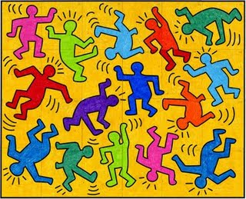
Complimentary Colors
Colors opposite each other on the color wheel.
There are three sets:
Red-Green
Yellow-Violet
Blue-Orange
When seen next to each other, complimentary colors make each other appear more intense.
When mixed together, complimentary colors will dull each other.
If mixed together at 50%/50% ratio any complimentary set will produce a brown color.

Slide 7
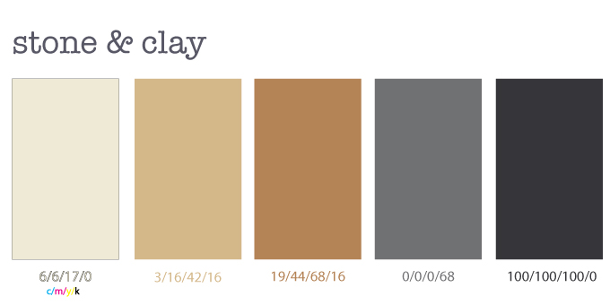
Neutral Colors
The neutral colors are a source of a more natural color in nature.
These colors include Brown, Black, Gray, and White
Black and White are not considered colors in Color Theory.
Black is the absence of all color
White is the presence of all color.

Slide 8
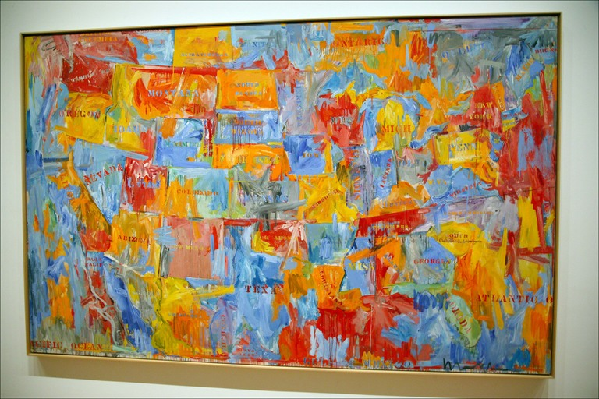
Tint
Shade
Mixing a color with white.
Mixing a color with Black.
Monochromatic
A scale from white to black using one color in between to form the tints and shades of one color. The full value range of one color.

Slide 9
Warm Colors
Cool Colors
Red
Orange
Yellow
Colors in which red and yellow are dominant.
Psychologically, warm colors seem to advance.
Green
Blue
Violet/Purple
Colors in which blue is dominant.
Psychologically cool colors seem to recede.

Slide 10
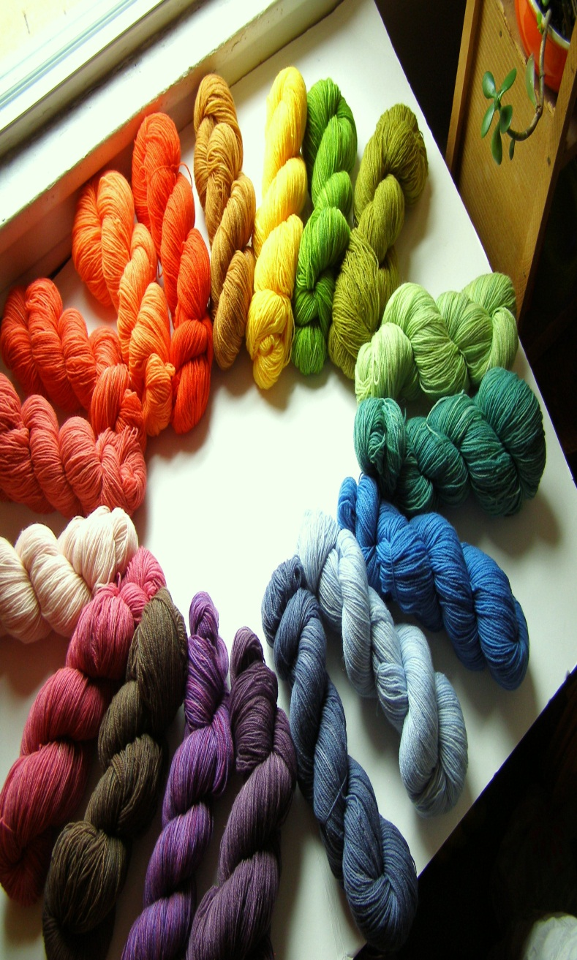
Vocabulary
Color Intensity: The intensity of a color is in direct relationship to the purity of the color.
Value: The visual weight of a color.
Value Scale: The gradation between light to dark on a scale.
Contrast: The difference between light and dark, size, color, shape, and textures.

