Slide 1
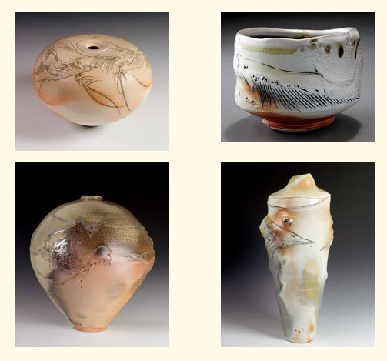
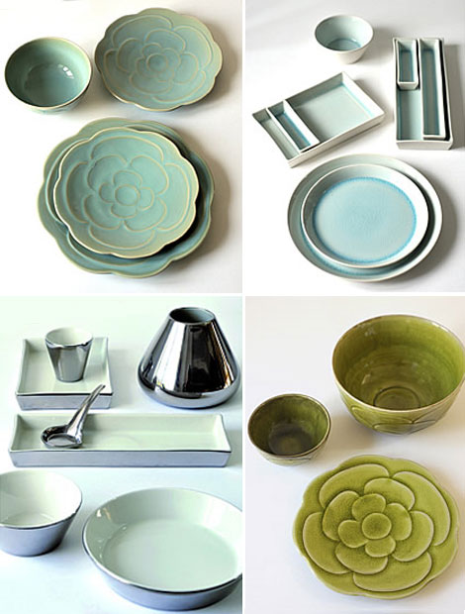
Famous Ceramic Artists

Slide 2
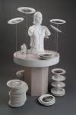
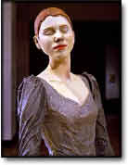
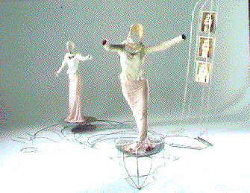
Nan Smith
She is known for her ceramic sculptures.
She sculpts realistic things such as people.
Her installations incorporate life-sized, realistic, earthenware figures, crafted metal or wooden constructions.
She uses a range of mold-making techniques and precise slab

Slide 3
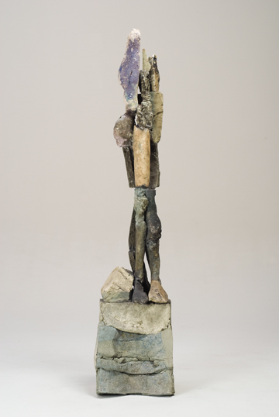
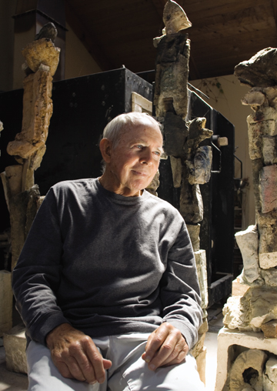
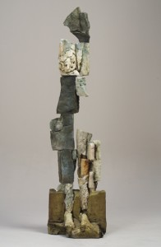
Stephen de Staebler
He was famous for creating ceramic sculptures.
He would create his art in pieces and then put them together, knowing that they would shrink to different sizes after being fired.
He created realistic things that often ended up looking imaginary. For example, he would create sculptures of men or women that would end up distorted.

Slide 4
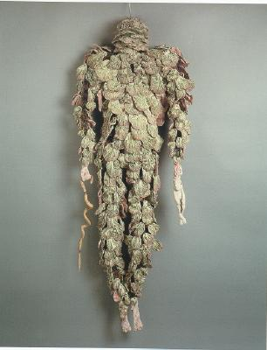
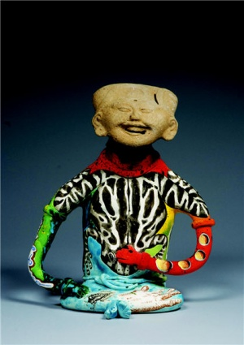
Michael Lucero
His pieces were very unique, he used nature inspiring details on most all of them.
He usually works in series. He created pieces working over a period of time before developing into another way to portray imagery.

Slide 5
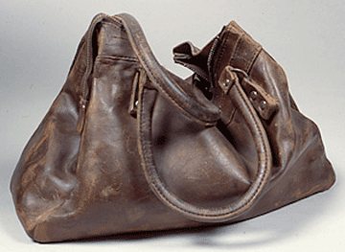
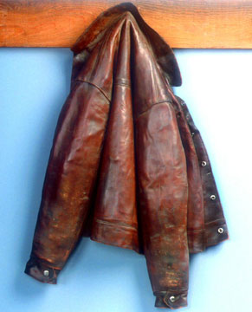
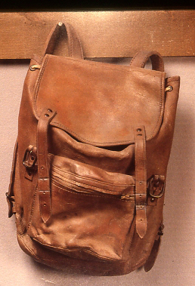
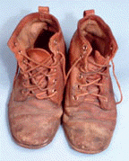
Marilyn Levine
She was a ceramic sculptor known for realistic leather goods.
She addresses every detail, showing stitching, folds, and seams of the objects.
Levine’s work shows a sense of history and humanity.

Slide 6
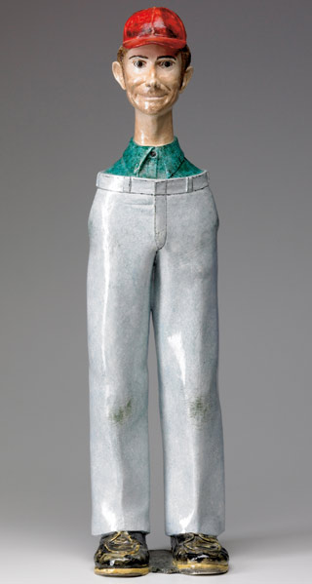
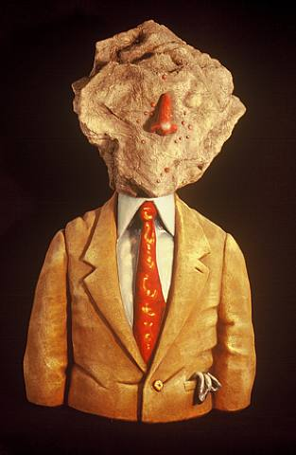
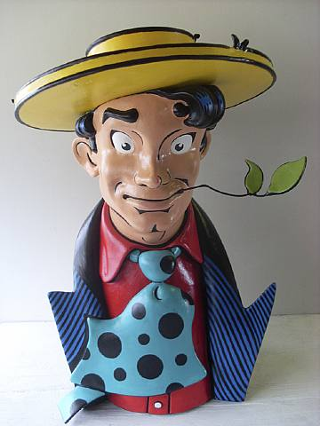
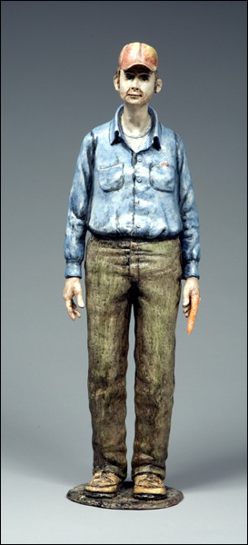
Jack Earl
Jack based his art off of Japanese inspired pottery.
He was known for creating ceramic sculptures portraying scenes of Midwestern life.

Slide 7
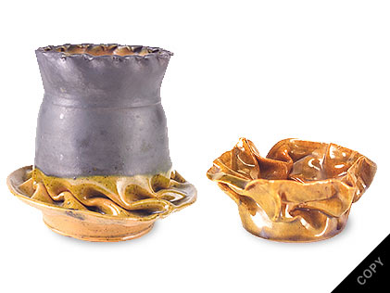
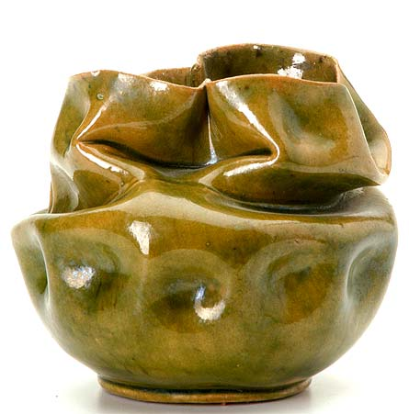
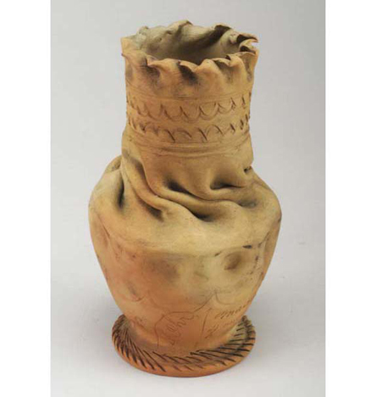
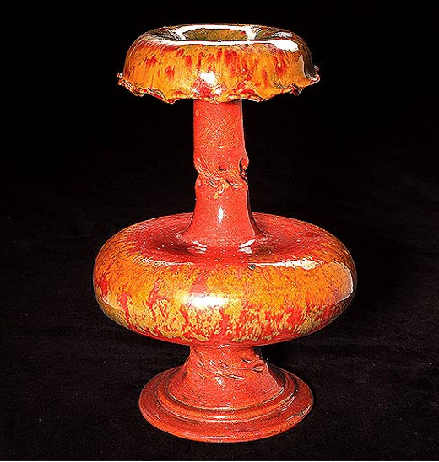
George Ohr
He was called the “Father of Modern Abstract Expressionism”.
His pieces are mainly thrown pottery that he distorted, creating a warped and twisted look.
The unique style named Ohr the reputation of an eccentric mad man.

Slide 8
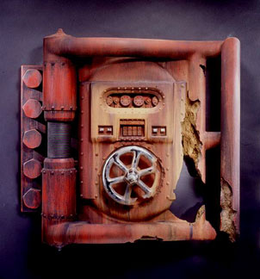
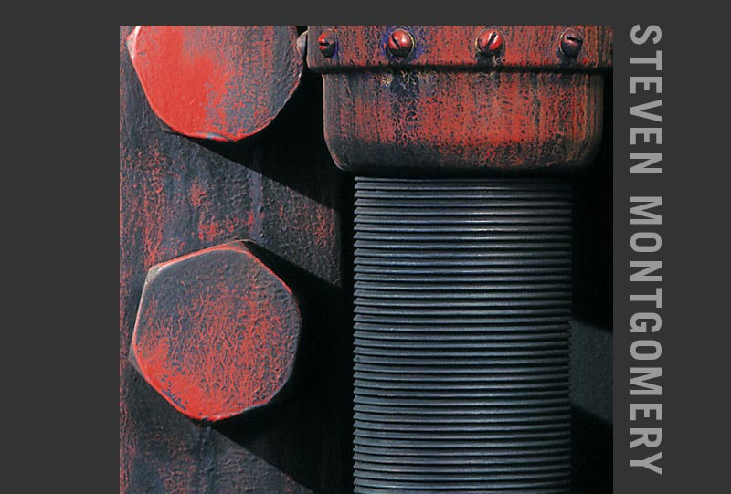
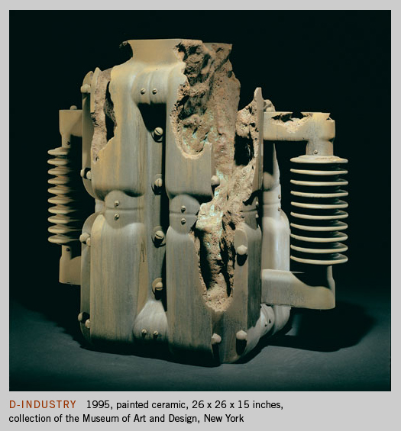
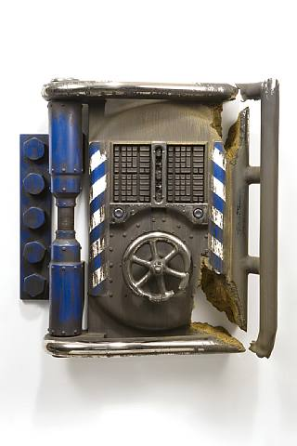
Steven Montgomery
Most of Steven’s work looks like Machinery
His past work is very rustic, old time machinery, rough edges, and looks antique.
His present work is modern, steel-like, with smoother lines.

Slide 9
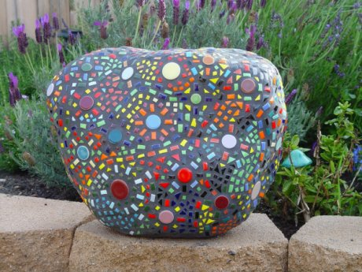
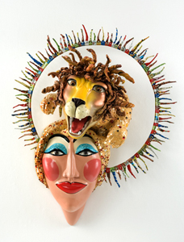
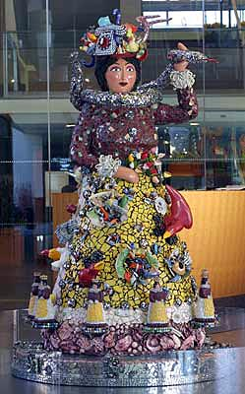
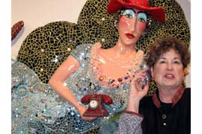
Judith Onofrio
Judy is known for creating large scale sculptural architectural artworks made with everyday items like broken dishes and mirror pieces to seashells.
She creates all her work in her backyard, it is a huge working gallery.

Slide 10
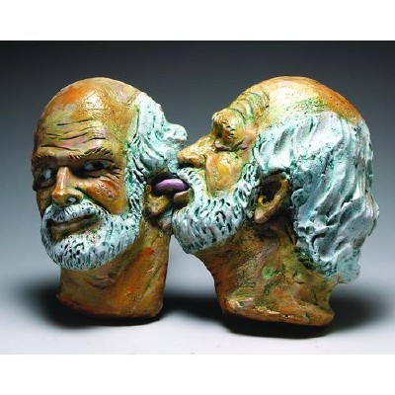
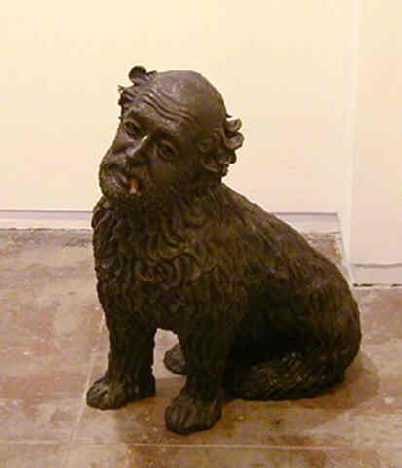
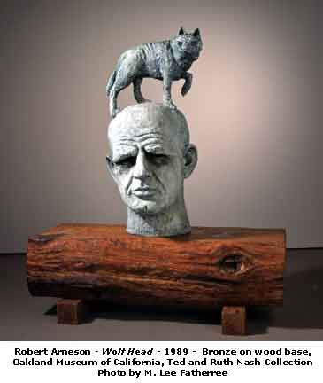
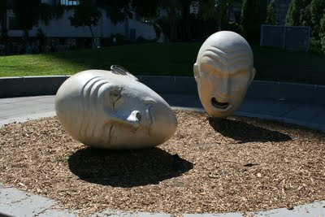
Robert Arneson
Arneson choose everyday objects as subjects for clay, depicting these objects with humor and surrealism.
Creates imaginary things.
People viewing his work should look beyond what seems to be edgy, naughty, or funny to find more serious comments about political, social, and economic issues.

Slide 11
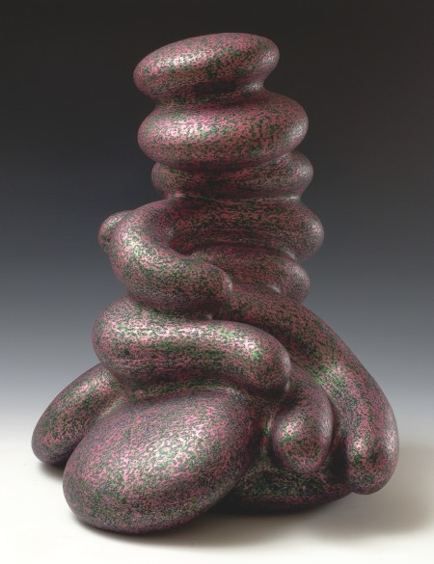
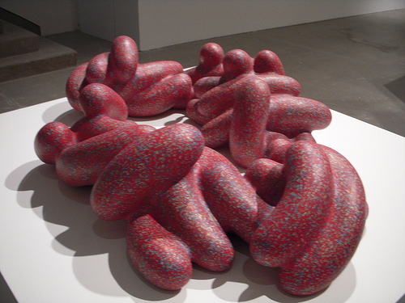
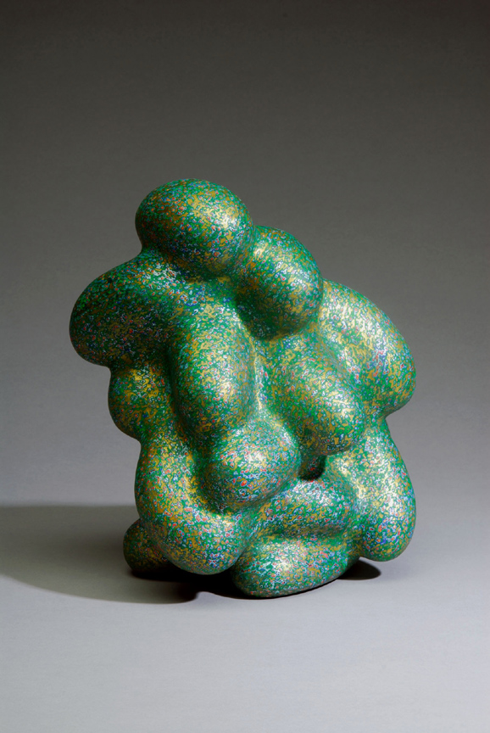
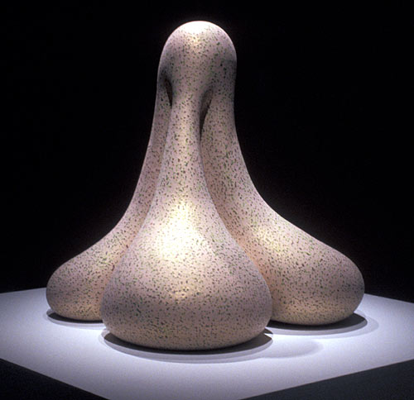
Ken Price
He is best known for his abstract shapes constructed from fired clay.
Typically, his work is not glazed, but painted with multiple layers of bright acrylic paint and then sanded down to reveal the colors beneath.
Ken Price has always had a love for the sea and the surf.
He is intrigued by the "forms of energy and the movement in waves." Ocean waves crashing against the shore are the sources and inspiration for Price’s newest sculptures.

Slide 12
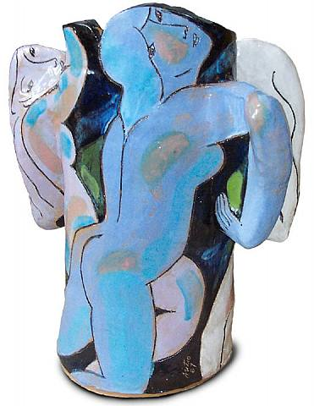
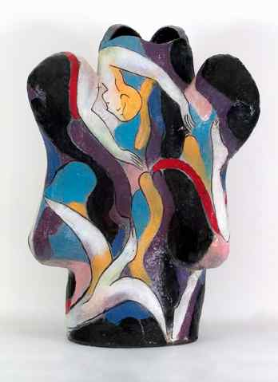
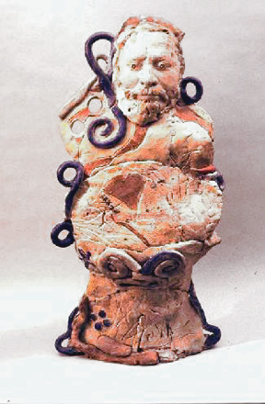
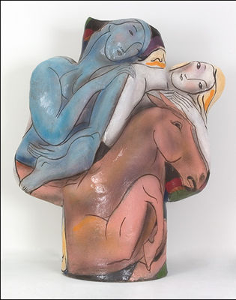
Rudy Autio
Rudy was a sculptor, best known for his ceramic objects.
His work is held in many museums because they like the animal shaped torso figures he created.
Beginning with a sturdy, hollow, ceramic trunk, Autio adds ear-like appendages or "cactus arm" extensions, each rounded and smoothed at the join to form subtle, curved transitions.

Slide 13
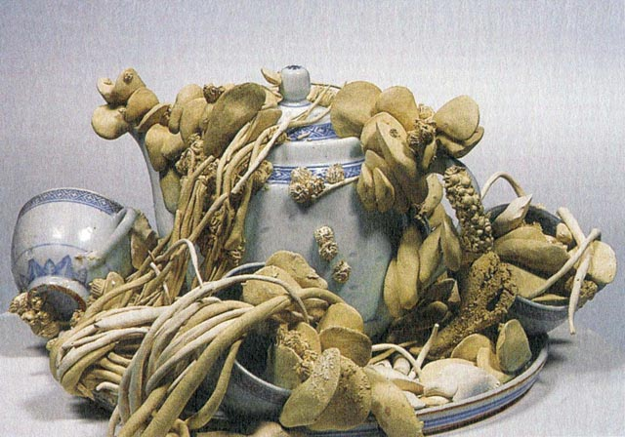
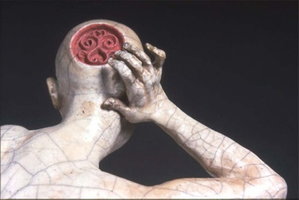
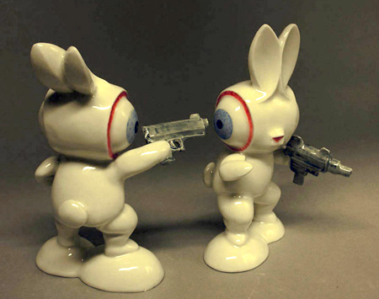
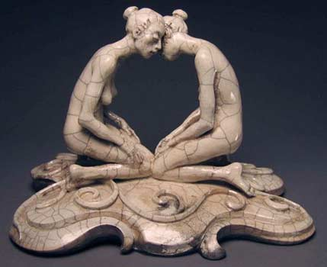
Justin Novak
He was a graphic artist before he became a ceramic artist.
His raku-fired expressive figurative sculptures navigate a fine line the between the tasteful and the grotesque.
He has always been interested in the historical genre of the figurine

Slide 14
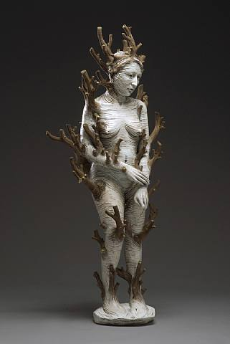
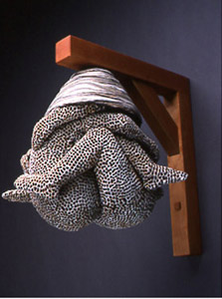
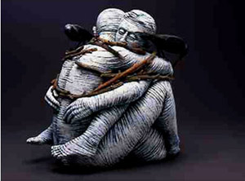
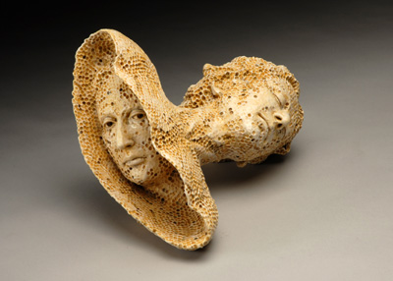
Adrian Arleo
A lot of work has to do with nature and things around her.
She combines people with nature.
Most of her sculptures are a mixture of realistic and imaginary things. She makes things look real, but with her own twist.
She was thirteen when she feel in love with clay, her mother was a ceramicist who taught her the language of clay.

