Slide 1
Lindsay Powers Portfolio
Remembering the past, appreciating the present, and looking forward to the future while working within the rustic elegance of nature. I am investigating childhood memories, a style of country living, and family histories.

Slide 2
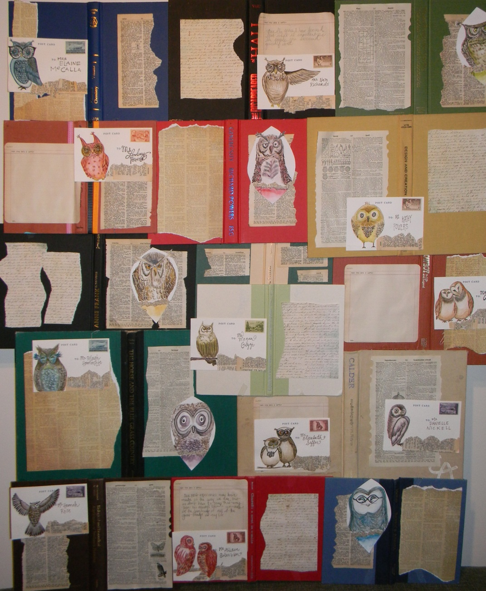
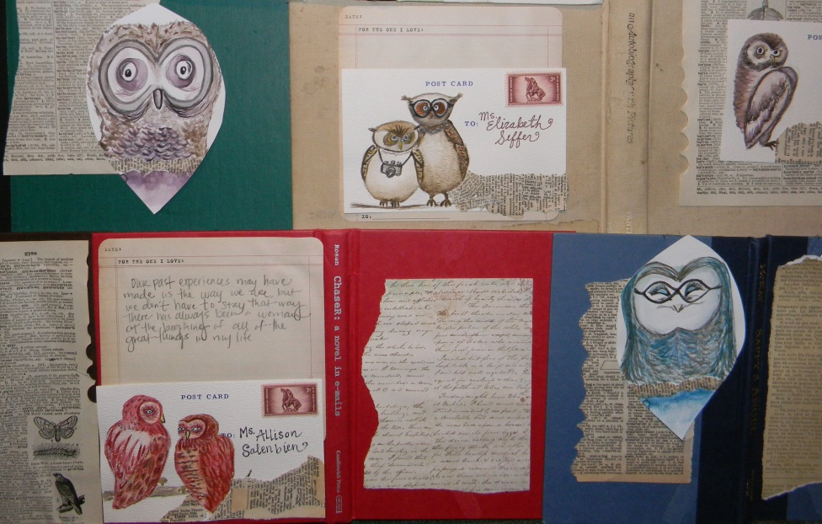
Postcard from home
My inspirational for this piece was the

Slide 3
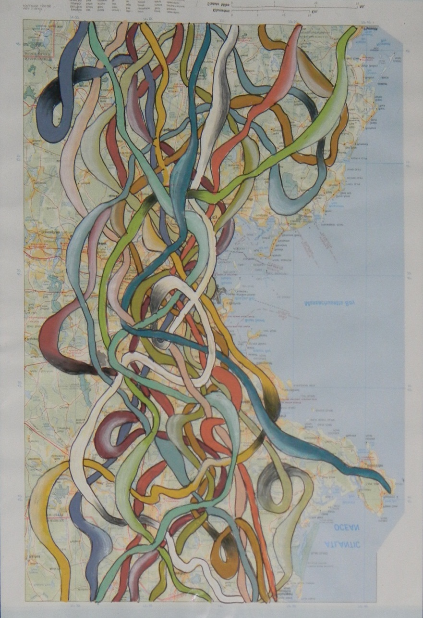
Intertwine Map

Slide 4
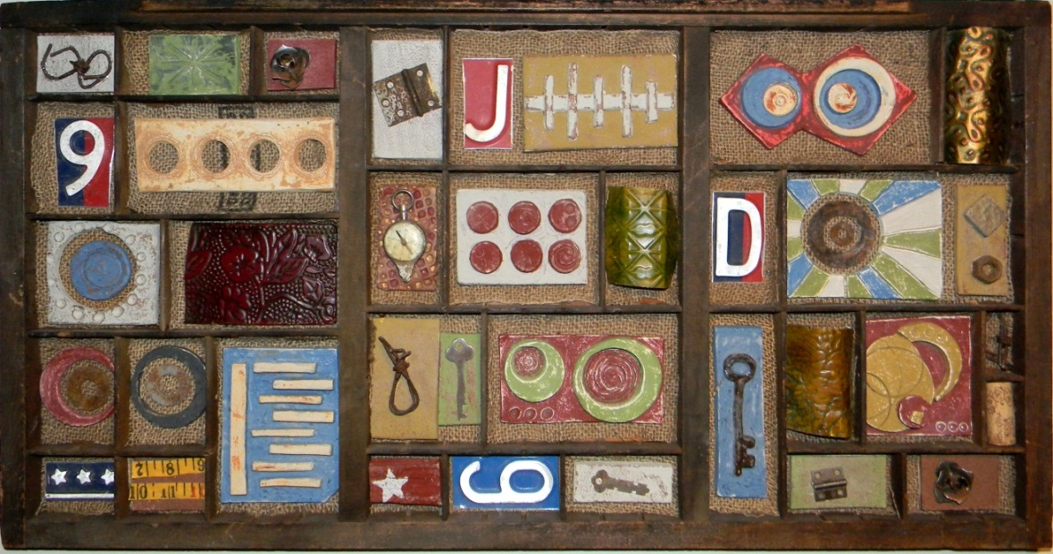
Pieced Together

Slide 5
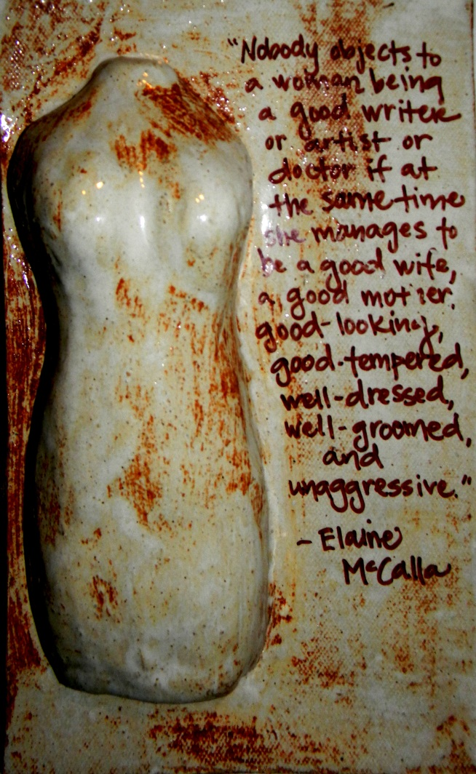
Women Speak

Slide 6
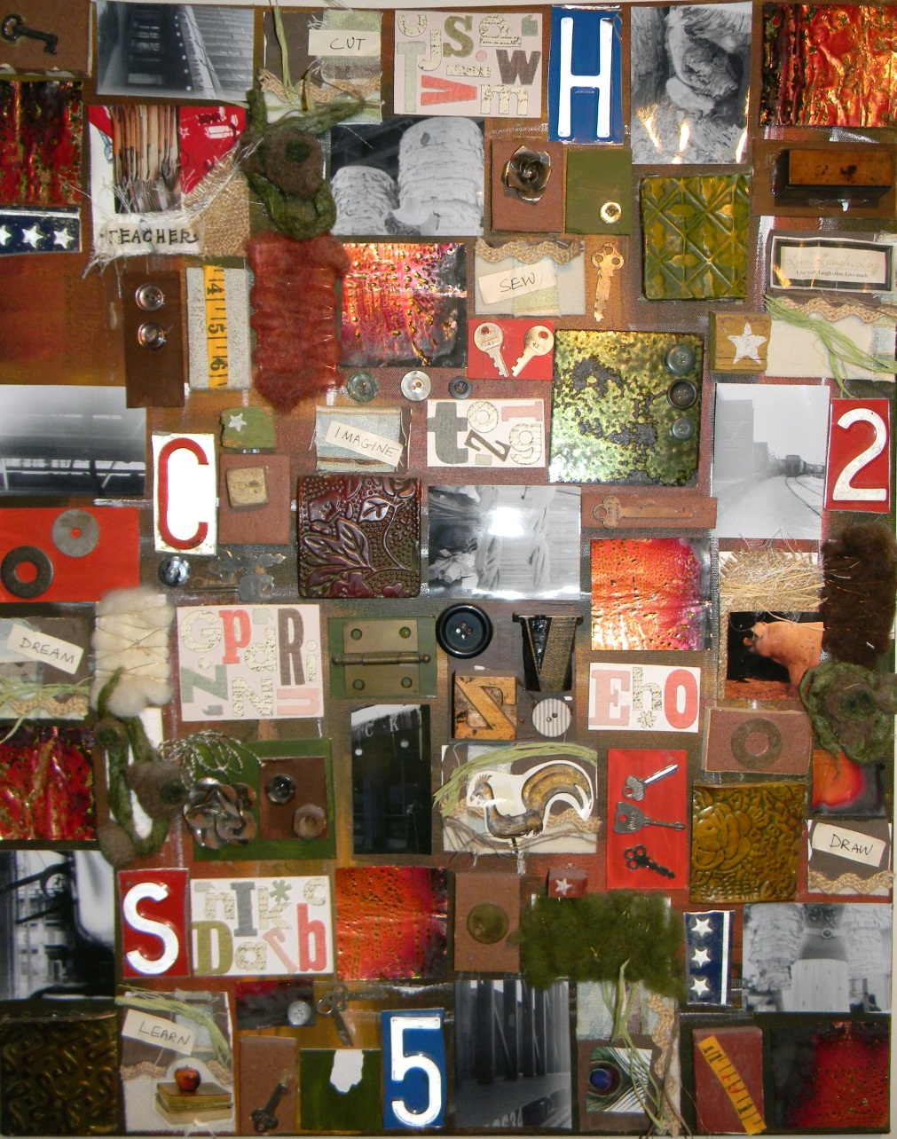
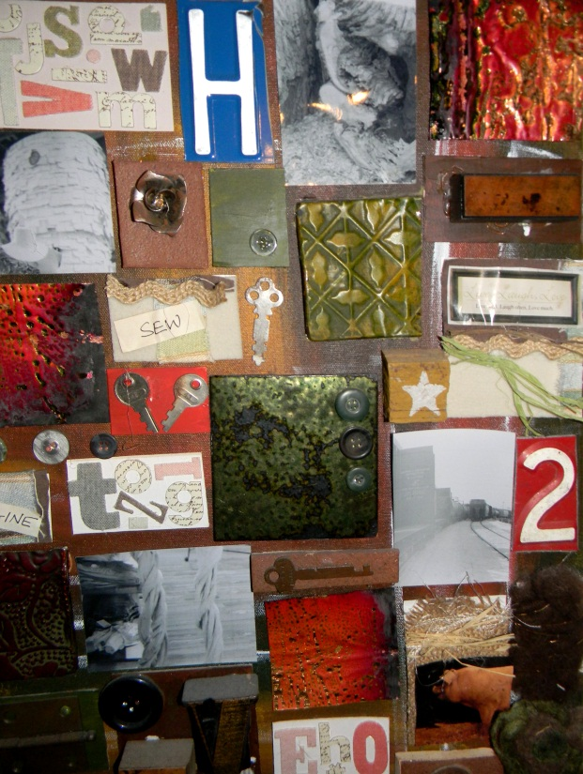
Discarded

