Slide 1
Perspective

Slide 2
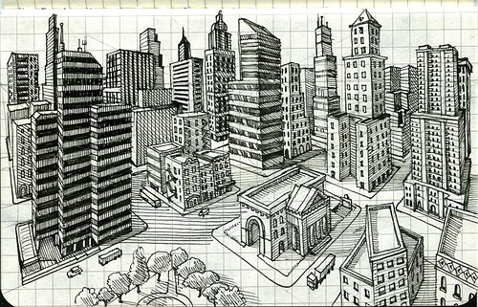
Perspective
Perspective: A special way we show distance and depth on a 2-D Plane.
Non-Linear Perspective: Showing distance and depth without using lines converging at a point on the horizon.

Slide 3
Linear Perspective
One Point Perspective – Objects appear smaller as they get farther away. There is one central vanishing point.
Two Point Perspective- There are two vanishing points for an object.
Horizon Line- Eye Level Line. Usually is present across the middle of the picture.
Vanishing Point- An imaginary point at which parallel lines converge on a horizon. This is where all lines will recede to.

Slide 4
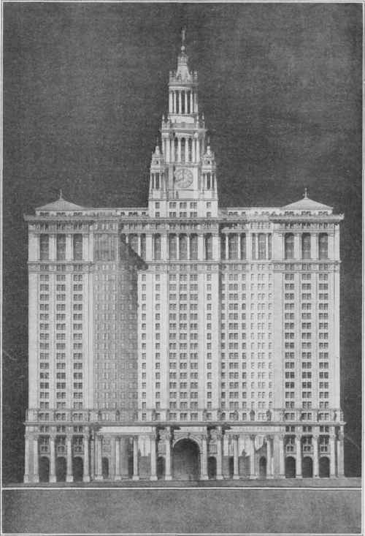
REFLECTION/Symmetry
Reflection is where you see a mirror image, in which left and right are reversed.
Surface Reflection depends on both the viewing and lighting of the scene.
Reflection is the same as Symmetry: Exact form on opposite sides of a dividing line or plane.

Slide 5
Ways to Show Distance Using Non-Linear Perspective
Changing the Size of Objects as they Go Back in the Distance: They get Smaller
Overlapping Objects and Making Largest and Closest to You be Totally Visible
Place Objects that are Closest to You at the Very Bottom of the Paper
Change Value of Objects: As they Go Back in the Distance, they get Lighter. The Closer they get to You, the Darker they Are. Shade and Shadow may be used to indicate distance.

Slide 6
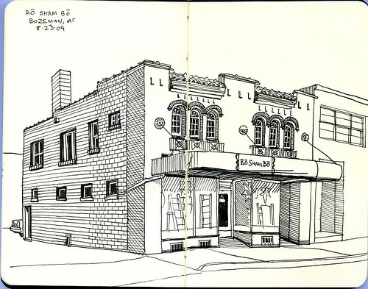

Slide 8
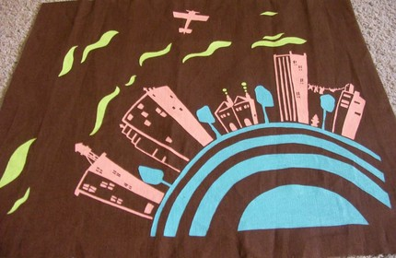

Slide 10
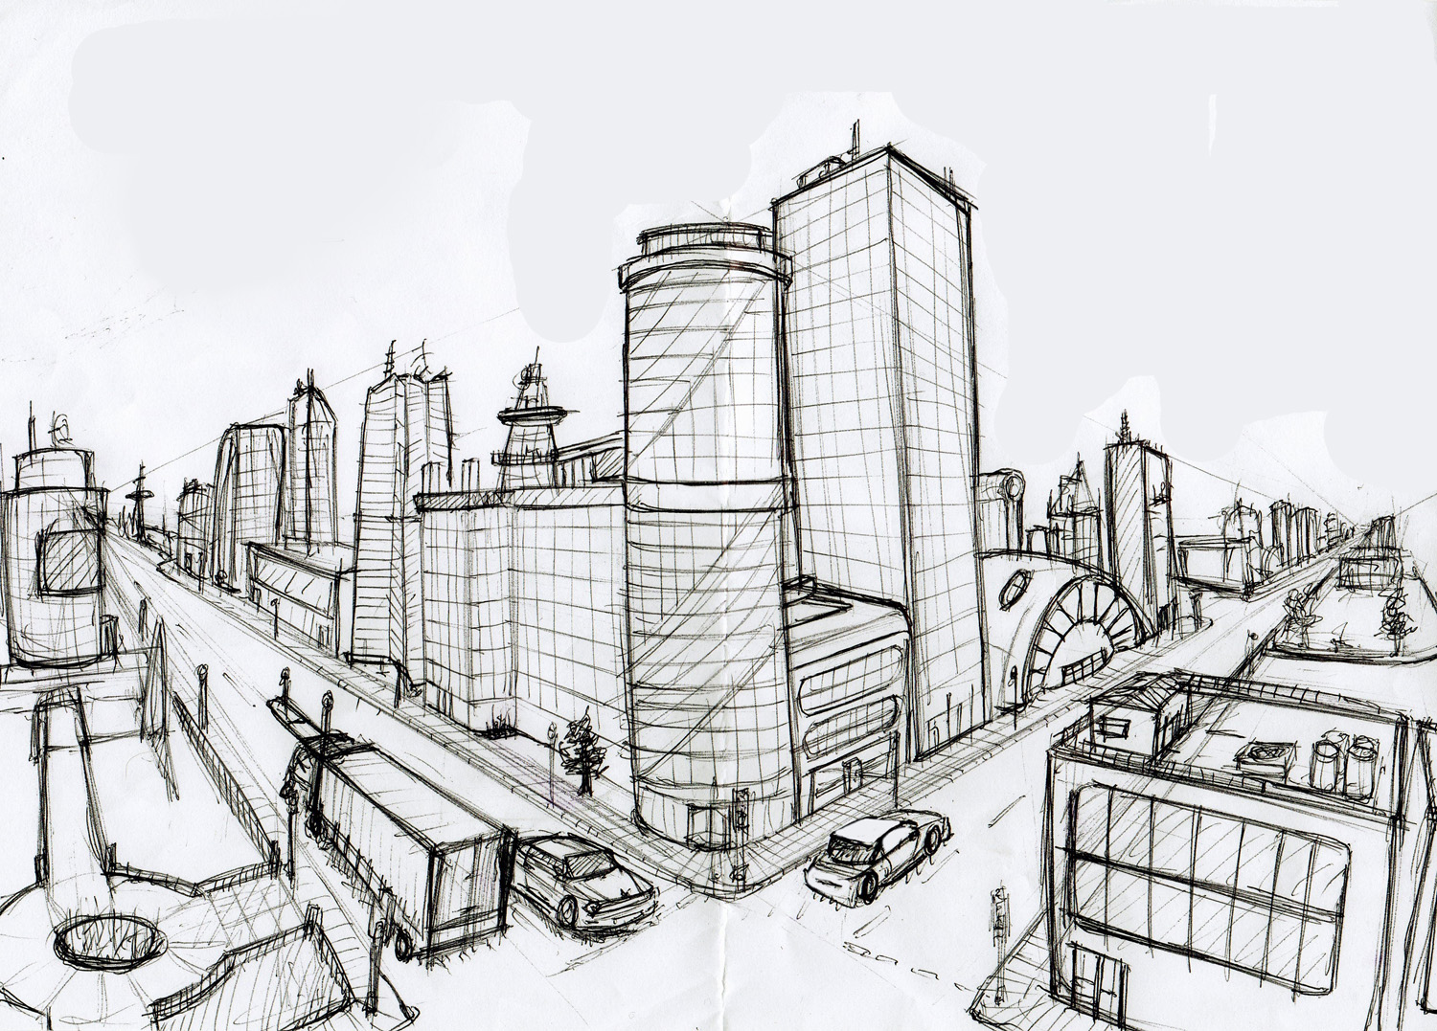

Slide 11
