Slide 1
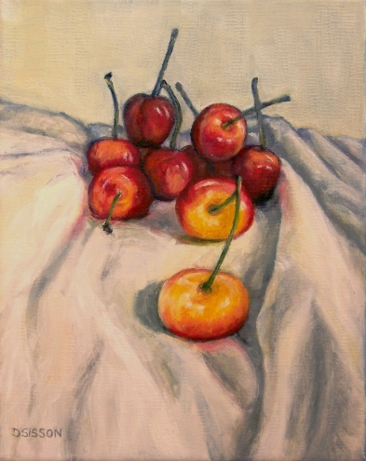
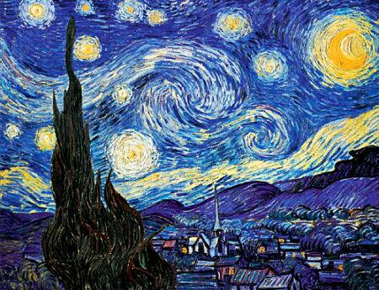
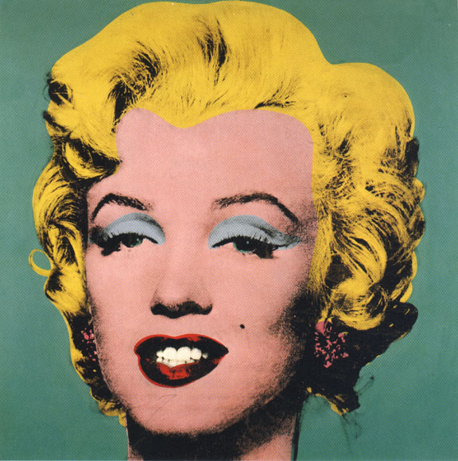
Painting Subject Matter
In painting, there are 3 different kinds of basic subject matter, that artist refer to, these are called: Still Life, Landscape, and Portrait.

Slide 2
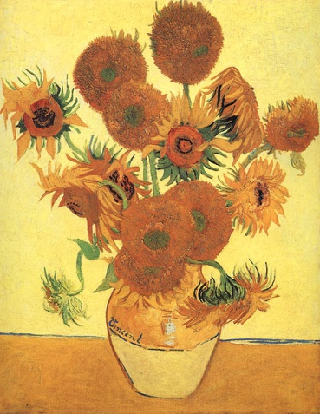
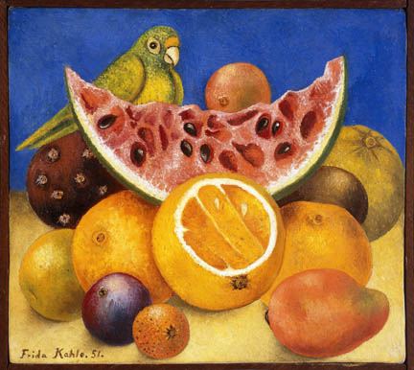
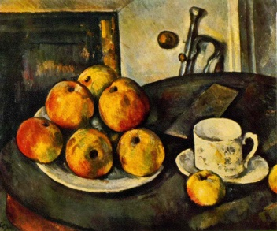
STILL LIFE
A still life is a painting of inanimate objects- items that cannot move. Things such as bottles, bowls, fruits, flowers, and cloth often appear in these works.
Still life pictures are meant to capture everyday life.
Still life artists find ways to arrange everyday objects in ways that give them a new context.
Combinations of bright sunlight and intense darkness are used in still life paintings.

Slide 3
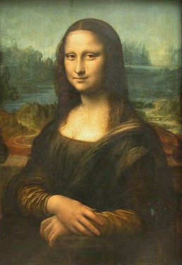
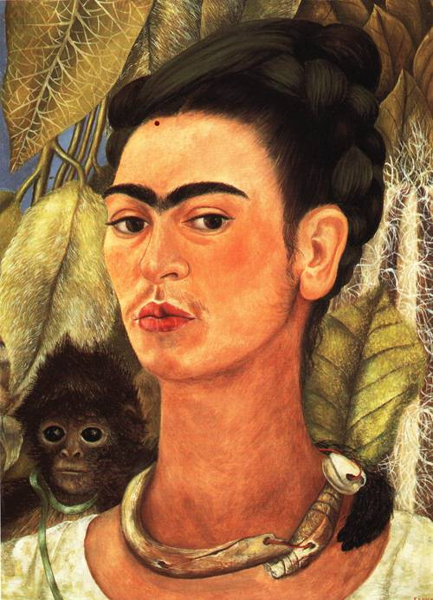
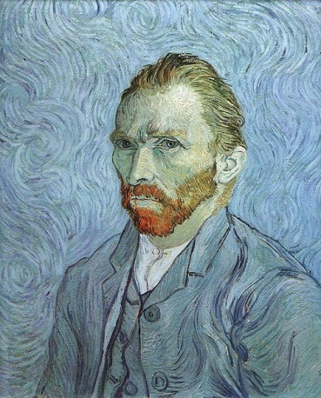
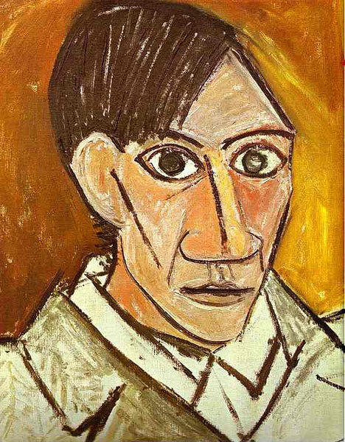
Portraits
A portrait is a work of art that is a representation of a person, in which the face and its expression is predominant.
The intent is to display the likeness, personality and even the mood of the person.
A portrait often shows a person looking directly at the painter or photographer, in order to most successfully engage the subject with the viewer.

Slide 4
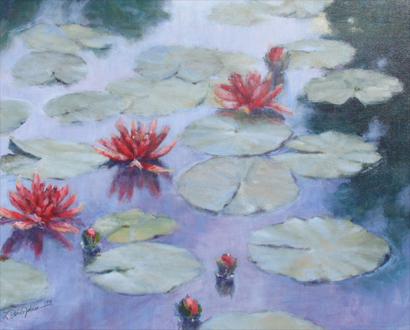
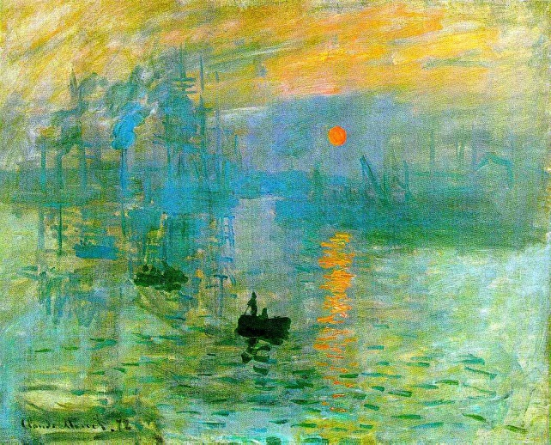
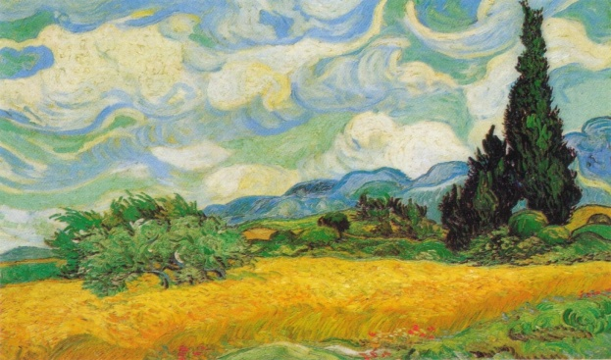
Landscape
In a landscape artwork the artist makes use of the natural or created environment.
For example a busy cityscape, courtyards and urban activity or a quiet mountaintop view of a forest and lake are both examples of landscape paintings.
Often landscapes and architectural scenes were painted to serve as "open windows" to provide a feeling of greater space in small rooms.

Slide 5
Importance of All 3
The still life teaches the importance of value. Within the confines of a relatively small distance, the influence of light and the manipulation of edge create form.
The portrait teaches accurate drawing. The human likeness allows for no error.
The landscape teaches color harmony. Natural light and its influence across nature’s palette help us to understand the relationship all colors have to one another.
“To learn value relationships, it’s the still life; to draw, it’s the portrait; and to become sensitive to color, it’s the landscape. Each has something to offer.

Slide 6
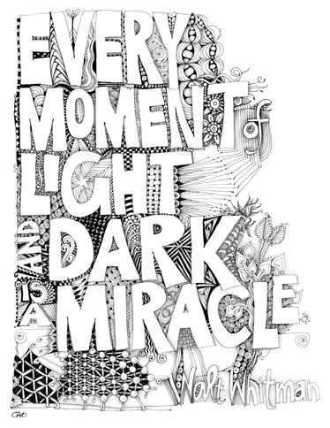
Introduce Yourself in Black and White

Slide 7
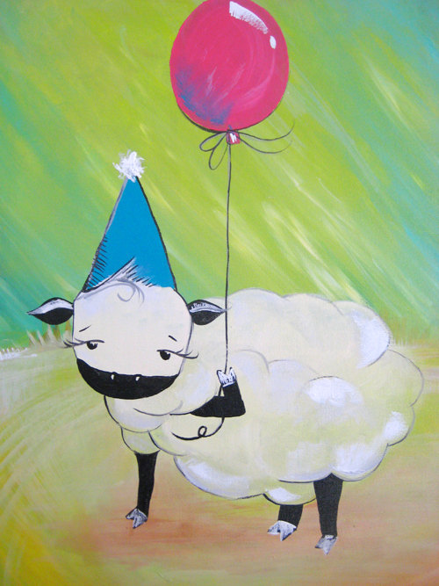
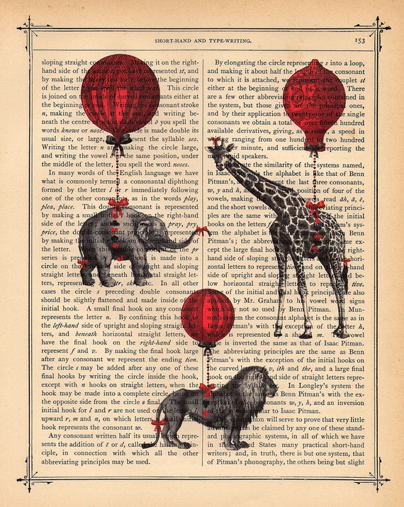
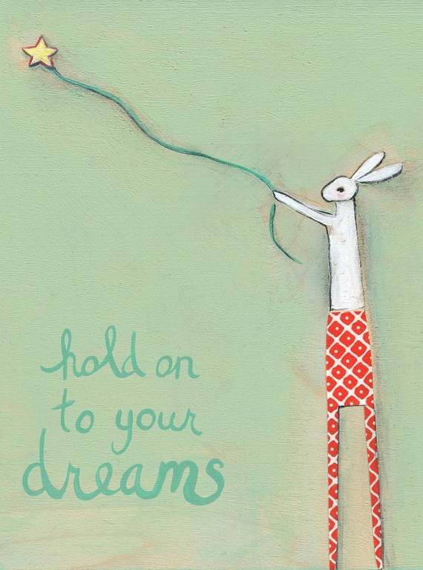
Up, Up, and Away Painting
Things that can make you float Up, Up, and Away:
Balloons, Birds, Butterflies, Umbrella, Hot Air Balloon, Kites, Stars, Clouds.

Slide 8
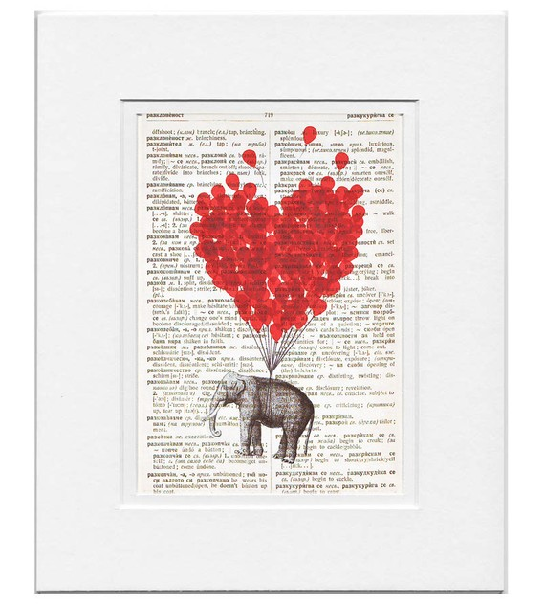
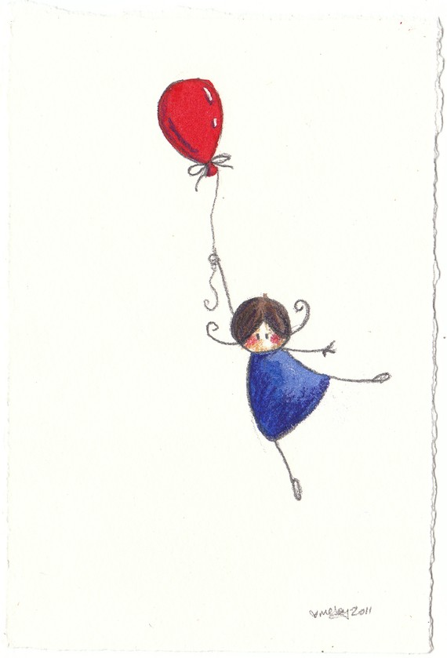
You need to remember that your animals or people do not need to be realistic, they can be cartoon. But you must have these things in your painting:
3 Animals
2 People
1 Floating Object
Some Kind of Landscape
And the Rest is Up to you!

Slide 9
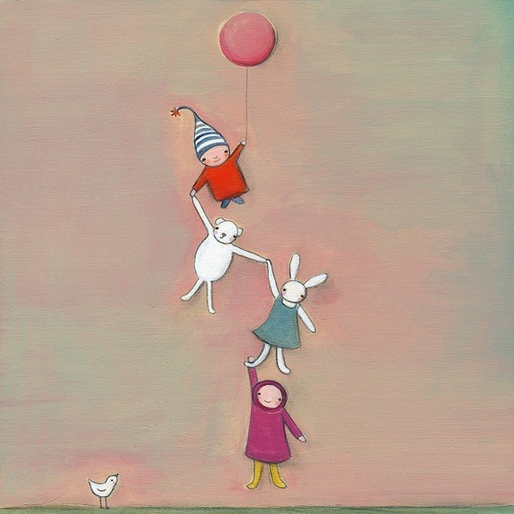
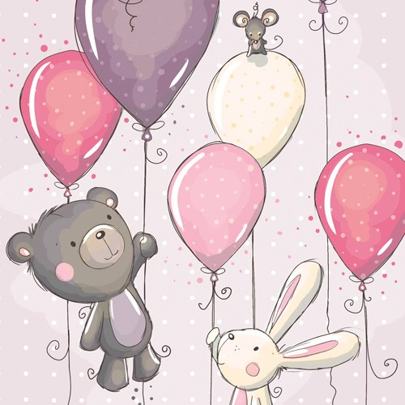

Slide 10
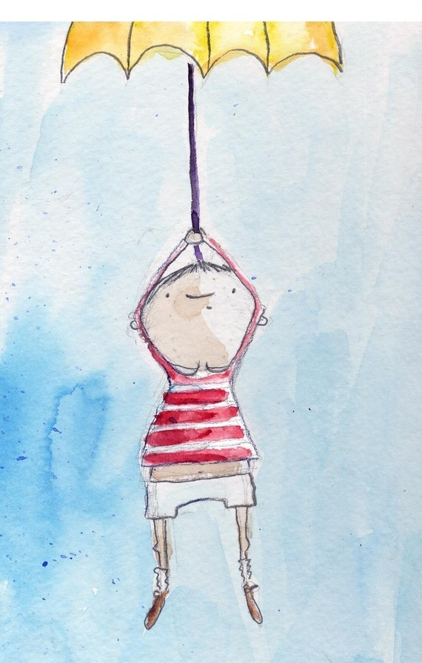
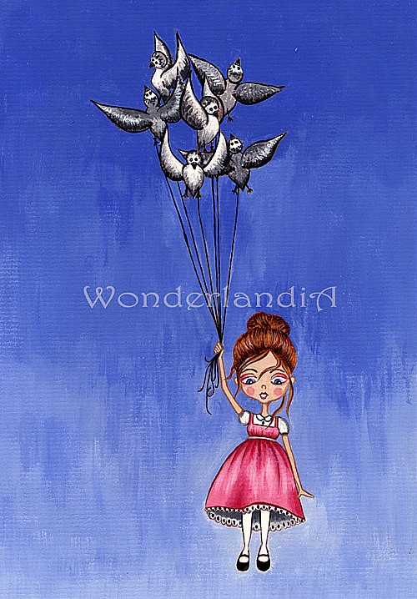

Slide 11
